Slide 1


TSCA: Opportunities for Engagement
2019 NASF Washington Forum
April 16, 2019
David Fischer, M.P.H., J.D.
Notes:
Want to engage in a discussion about TSCA and its opportunities for industry engagement
I tried to focus on what I think are some of the key new TSCA developments

Slide 2
Agenda
Introduction
TSCA Safety Standard
Multi-step chemical evaluation process
    Prioritization
    Risk Evaluation
    What’s ahead for Congress on PFAS?

Slide 3
TSCA Implementation Offers Challenges and Opportunities
The 2016 amendments to TSCA dramatically changed the regulatory landscape for existing chemicals.
TSCA sets forth a transparent and robust scientific public process for the prioritization and risk evaluation of chemicals.
  Science decisions must be based on the best available science and the weight of the scientific evidence.
Understanding these changes is critical to taking full advantage of the opportunities to proactively engage in the process.
Notes:
In EPA’s proposed prioritization rule, EPA makes clear that scientific uncertainty as a result of insufficient information for example will weigh in favor of a high-priority substance designation. EPA needs to have sufficient information to establish that a chemical is a low-priority substance, a decision that represents final agency action and is therefore reviewable in court.

Slide 4
TSCA Safety Standard
Does the chemical:
Present an unreasonable risk of injury to health or the environment,
Without consideration of costs or other non-risk factors,
Including an unreasonable risk to potentially exposed or susceptible subpopulation,
Under the conditions of use?

Slide 5
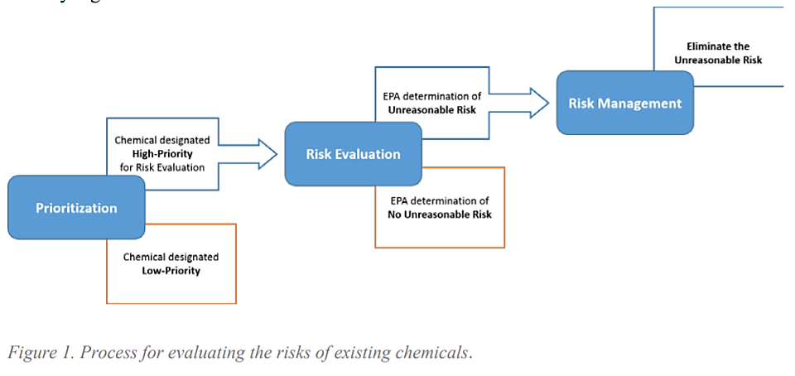
EPA’s Multi-step Approach to Chemical Evaluation

Slide 6
Prioritization
Prioritization is a 9 – 12 month public process which results in chemicals prioritized as:
  High priority = may present an unreasonable risk
      Must undergo risk evaluation.
  Low priority = not high priority
      Low priority ≠ low or no risk
      Does not warrant risk evaluation at this time.
EPA must consider a number of factors including conditions of use, hazard and exposure potential, susceptible subpopulations, persistence and bioaccumulation.

Slide 7
Prioritization
In the near-term EPA will look first to the 2014 Work Plan for potential high-priority chemical candidates.
  At least 50% of all chemical substances undergoing risk evaluation must be drawn from the 2014 Work Plan, but…
  20 chemicals recently nominated for high-priority designation are all drawn from the Work Plan.
    No metals on list of 20

Slide 8
Prioritization
Stakeholders should assume that EPA will continue to draw exclusively from the Work Plan.
The list of chemicals on the Work Plan has now been whittled down to 53, from a high of 90 or more.
Metals on list include: Nickel and Nickel Compounds; Cadmium & Cadmium Compounds; Chromium & Chromium Compounds; Cobalt & Cobalt Compounds; Lead & Lead Compounds; Molybdenum and Molybdenum Compounds.

Slide 9
Risk Evaluation
Risk Evaluation
High priority designation triggers a risk evaluation.
Must be completed within 3 years with possible 6-month extension.
EPA may issue its risk determination on a subset of conditions of use and continue to evaluate the remaining conditions of use.
Answers the question: Does the chemical present an unreasonable risk for each condition of use evaluated?
Notes:
Anne – in the word document there were changes to these bullets, but this is the text you had already edited, so I kept it as is.

Slide 10
Risk Evaluation
When EPA concludes each risk evaluation, it must designate another high priority chemical for risk evaluation.
Thus, EPA will have at least 20 EPA-initiated risk evaluations underway at all times beginning in December 2019.
Fee amount for EPA-initiated risk evaluations = $1.35 M (to be paid in full).
.
Notes:
Anne – in the word document there were changes to these bullets, but this is the text you had already edited, so I kept it as is.

Slide 11
Risk Evaluation
Risk Evaluation
Manufacturer requested risk evaluations
A manufacturer may petition to have EPA conduct a risk evaluation on its chemical and may choose to focus only on those conditions of use of interest to the manufacturer.
    Manufacturer must submit all information to EPA necessary to complete the risk evaluation for those conditions of use.
    EPA will publish a Federal Register notice for public comment.
  The chemical does not undergo prioritization and therefore avoids the potential label of “high priority.”
Initial payment for work plan chemical of $1.25 M, with balance due when risk evaluation is completed.
.
Notes:
Anne – in the word document there were changes to these bullets, but this is the text you had already edited, so I kept it as is.

Slide 12
Framework for Metals Assessment
Congress mandated its use for both prioritization and risk evaluation.
The current version is 12 years old (last updated in 2007).
Does it need updating prior to its use?

Slide 13
What’s ahead for Congress on PFAS?
From Senator Barrasso’s remarks at the March 28, 2019, E&PW Committee hearing on federal response to risks associated with PFAS chemicals:
    Scientists have found that PFAS breaks down very slowly, if at all, in the natural environment.
    They have also found that some accumulate in the human body.
    These chemicals travel through water, through air, through soil.
    Humans absorb them through ingestion, inhalation, and their skin.
    It is estimated that 97 percent of Americans have detectable concentrations of PFAS in their blood.
    Scientists believe PFAS are associated with negative health effects, and more research is needed.

Slide 14
What’s ahead for Congress on PFAS?
Congressional PFAS Task Force
  Congressman Dan Kildee (MI-05) and Congressman Brian Fitzpatrick (PA-01) created bipartisan Congressional PFAS Task Force at the start of the 116th Congress.
PFAS Task Force Objectives
    Hold informational events to educate Members of Congress and their staff to increase awareness about PFAS chemicals.
    Craft legislation to address PFAS contamination.
    Meet with congressional leadership, committee chairs and ranking members to ensure PFAS is adequately and more urgently addressed.
    Fight for more robust funding through federal appropriations to clean up PFAS contamination.

Slide 15
What’s ahead for Congress on PFAS?
*Note: For some newer bills, titles and bill text have not yet been released
S.1105
Sponsor: Sen. Jeanne Shaheen, [D-NH]
Introduced 04/10/2019
    Requires the Secretary of Veterans Affairs to establish and maintain a registry for certain individuals who may have been exposed to per- and polyfluoroalkyl substances due to the environmental release of aqueous film-forming foam on military installations.
    H.R.2195
    Sponsor: Rep. Chris Pappas, [D-NH-1]
    Introduced 04/10/2019

Slide 16
What’s ahead for Congress on PFAS?
S.1023
Sponsor: Sen. Debbie Stabenow, [D-MI]
Introduced 04/03/2019
      Amends title 38, United States Code, to furnish hospital care and medical services to veterans, members of the reserve components of the Armed Forces, and dependents who were stationed at military installations at which they were exposed to PFOA or other PFAS to provide for a presumption of service connection for those veterans and members of the reserve components, and for other purposes.
H.R.2102
Sponsor: Rep. Daniel Kildee, [D-MI-5]
Introduced 04/04/2019

Slide 17
What’s ahead for Congress on PFAS?
S.950: PFAS Detection Act of 2019
Sponsor: Sen. Debbie Stabenow, [D-MI]
Introduced 03/28/2019
      Requires the Director of the United States Geological Survey to perform a nationwide survey of perfluorinated compounds, and for other purposes.
H.R.1976
Sponsor: Rep. Daniel Kildee, [D-MI-5]
Introduced 03/28/2019

Slide 18
What’s ahead for Congress on PFAS?
S.858: Protecting Military Firefighters from PFAS Act
Sponsor: Sen. Jeanne Shaheen, [D-NH]
Introduced 03/25/2019
      Requires the Secretary of Defense to provide blood testing for firefighters of the Department of Defense to determine potential exposure to PFAS, and for other purposes.
H.R. 1863
Sponsor: Rep. Donald Norcross, [D-NJ-1]
Introduced 03/25/2019

Slide 19
What’s ahead for Congress on PFAS?
S.675: Prompt and Fast Action to Stop Damages Act of 2019
Sponsor: Sen. Tom Udall, [D-NM]
Introduced 03/06/2019
      Authorizes the Department of Defense to temporarily provide water uncontaminated with PFAS for agricultural purposes to areas affected by contamination from military installations, and authorizes the Secretary of the Air Force to acquire real property to extend the contiguous geographic footprint of any Air Force base that has shown signs of contamination from PFOA and PFOS due to activities on the base, and for other purposes.
H.R.1567
Sponsor: Rep. Ben Ray Lujan, [D-NM-3]
Introduced 03/06/2019

Slide 20
What’s ahead for Congress on PFAS?
S.638: PFAS Action Act of 2019
Sponsor: Sen. Tom Carper, [D-DE]
Introduced 02/28/2019
      Requires the Administrator of the Environmental Protection Agency to designate PFAS as hazardous substances under the Comprehensive Environmental Response, Compensation, and Liability Act of 1980, and for other purposes.
H.R.535
Sponsor: Rep. Debbie Dingell, [D-MI-12]
Introduced 01/14/2019

Slide 21
What’s ahead for Congress on PFAS?
S.611: Water Affordability, Transparency, Equity, and Reliability Act of 2019 Sponsor: Sen. Bernie Sanders, [I-VT]
Introduced 02/28/2019
      Provides assistance to a publicly owned, operated, and managed community water system for the purpose of updating a treatment plant or switching water sources due to contamination from PFAS and provides assistance in the form of a grant to an owner of a household water well that has been contaminated by PFAS.
H.R.1417
Sponsor: Rep. Brenda Lawrence, [D-MI-14]
Introduced 02/28/2019

Slide 22
About IBEX Partners
IBEX Partners is a Washington, D.C.-based consultancy built to serve clients with public policy interests in Washington, D.C., in state and local markets, and around the world.
We offer our clients:
Public affairs and issues management
Legal and regulatory affairs engagement
Reputation building
Stakeholder engagement
Crisis communications
Government relations
Grassroots and international reach
www.ibexdc.com

