Slide 1
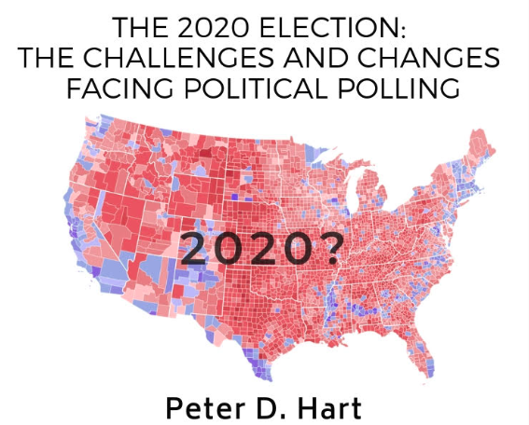
2020

Slide 2
Do you know your fellow American?
Pay most of your bills on line?
Attend religious services once a week or more?
Use Social Media once a day or more?
Blocked/unfriended for their political positions?
Have applied for a job using online job search?
63%
40%
69%
26%
42%
32%

Slide 3
2016 can you ever believe the polls?
Trump | Clinton | Other | Undecided
% % % %
Final Results 46 48 6
NBC/WSJ 40 44 8 8
ABC/Post 43 47 5 5
NYT/CBS 41 45 7 7
LA Times 48 43 9
IBD/TIPP 43 41 8 8
Survey Monkey 41 47 8 4

Slide 4
Vote Choice Over Time
Among Voters who are Negative to both Trump and Clinton
Early
Oct
Late
Oct
June
July
August
Sept
Nov
Exits
% of electorate
Clinton
Trump
Johnson/Stein
DIFFERENTIAL
DIFFERENTIAL
20%
19%
19%44%0
21%
16%
16%
48%
0
18%
15%
15%
50%
0
17%
13%
23%
47%
-10
19%
17%
23%
34%
-6
16%
18%
25%
35%
-10
15%
14%
24%
36%
-10
18%
30%
47%
23%
-17
Notes:
December 1992 4035 – USE FOR OCTOBER 1992 TOO SINCE WE SHOW RV TREND THERE.
October 2000 -- 6009
October 2008 – 6089
October 2016 9506k
9506n RVs

Slide 5
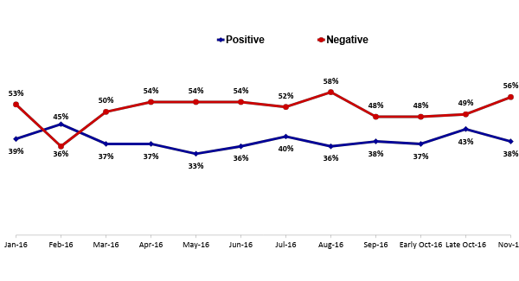
Hillary Clinton Feelings Over Time
Among PA, MI, OH, and WI Voters
Notes:
Q.5

Slide 6
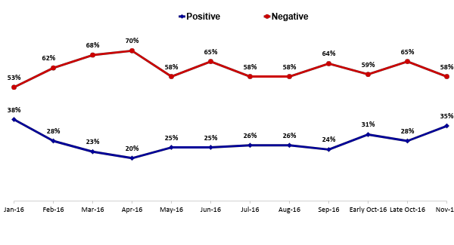
Donald Trump Feelings Over Time
Among PA, MI, OH, and WI Voters
Notes:
Q.5

Slide 7
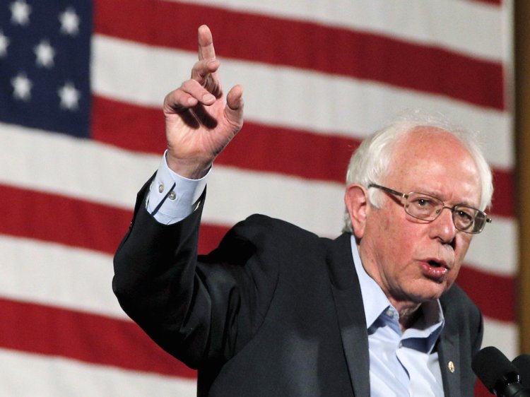
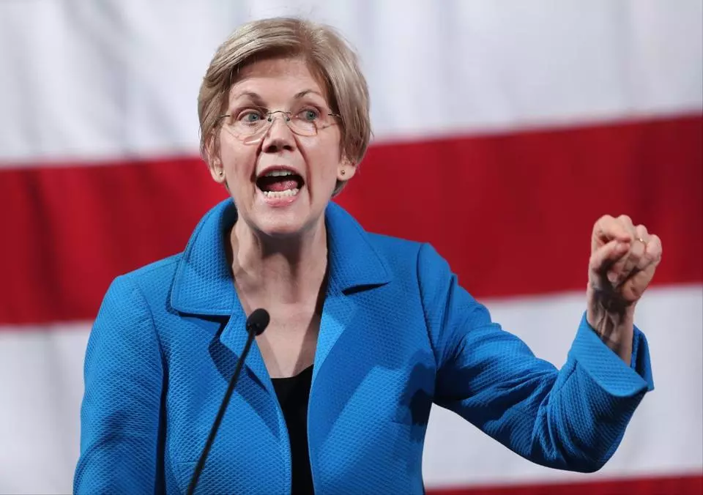
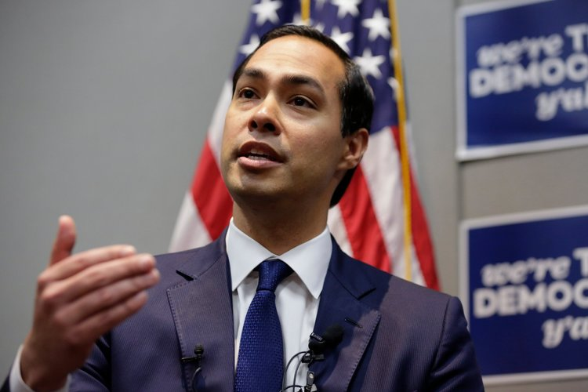
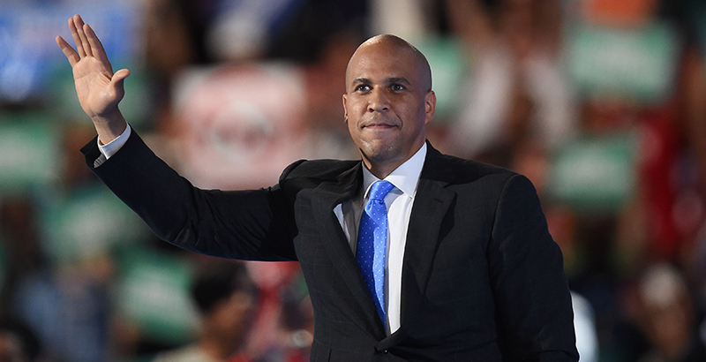
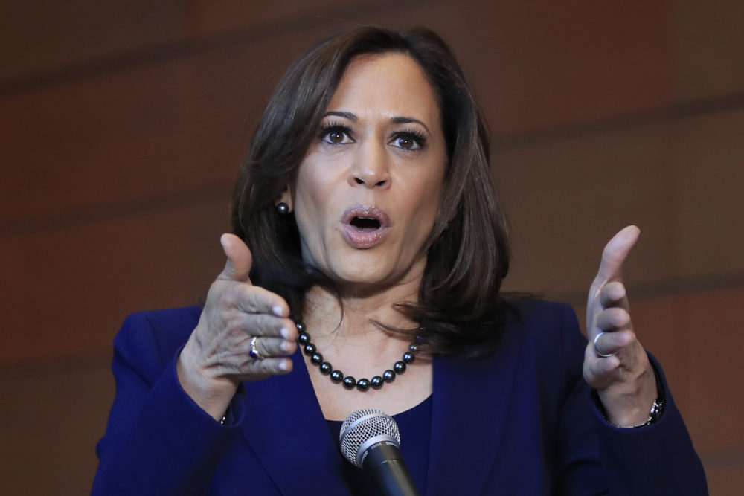
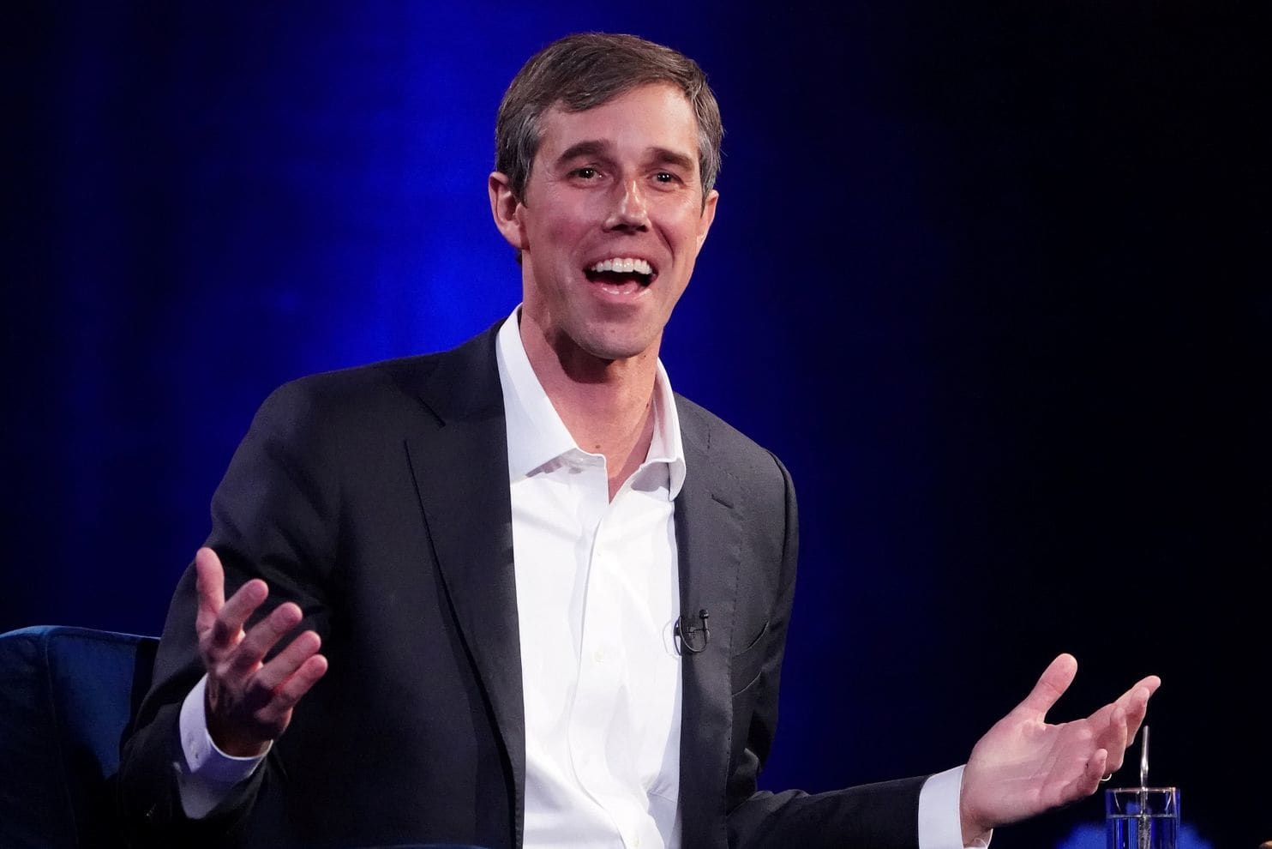
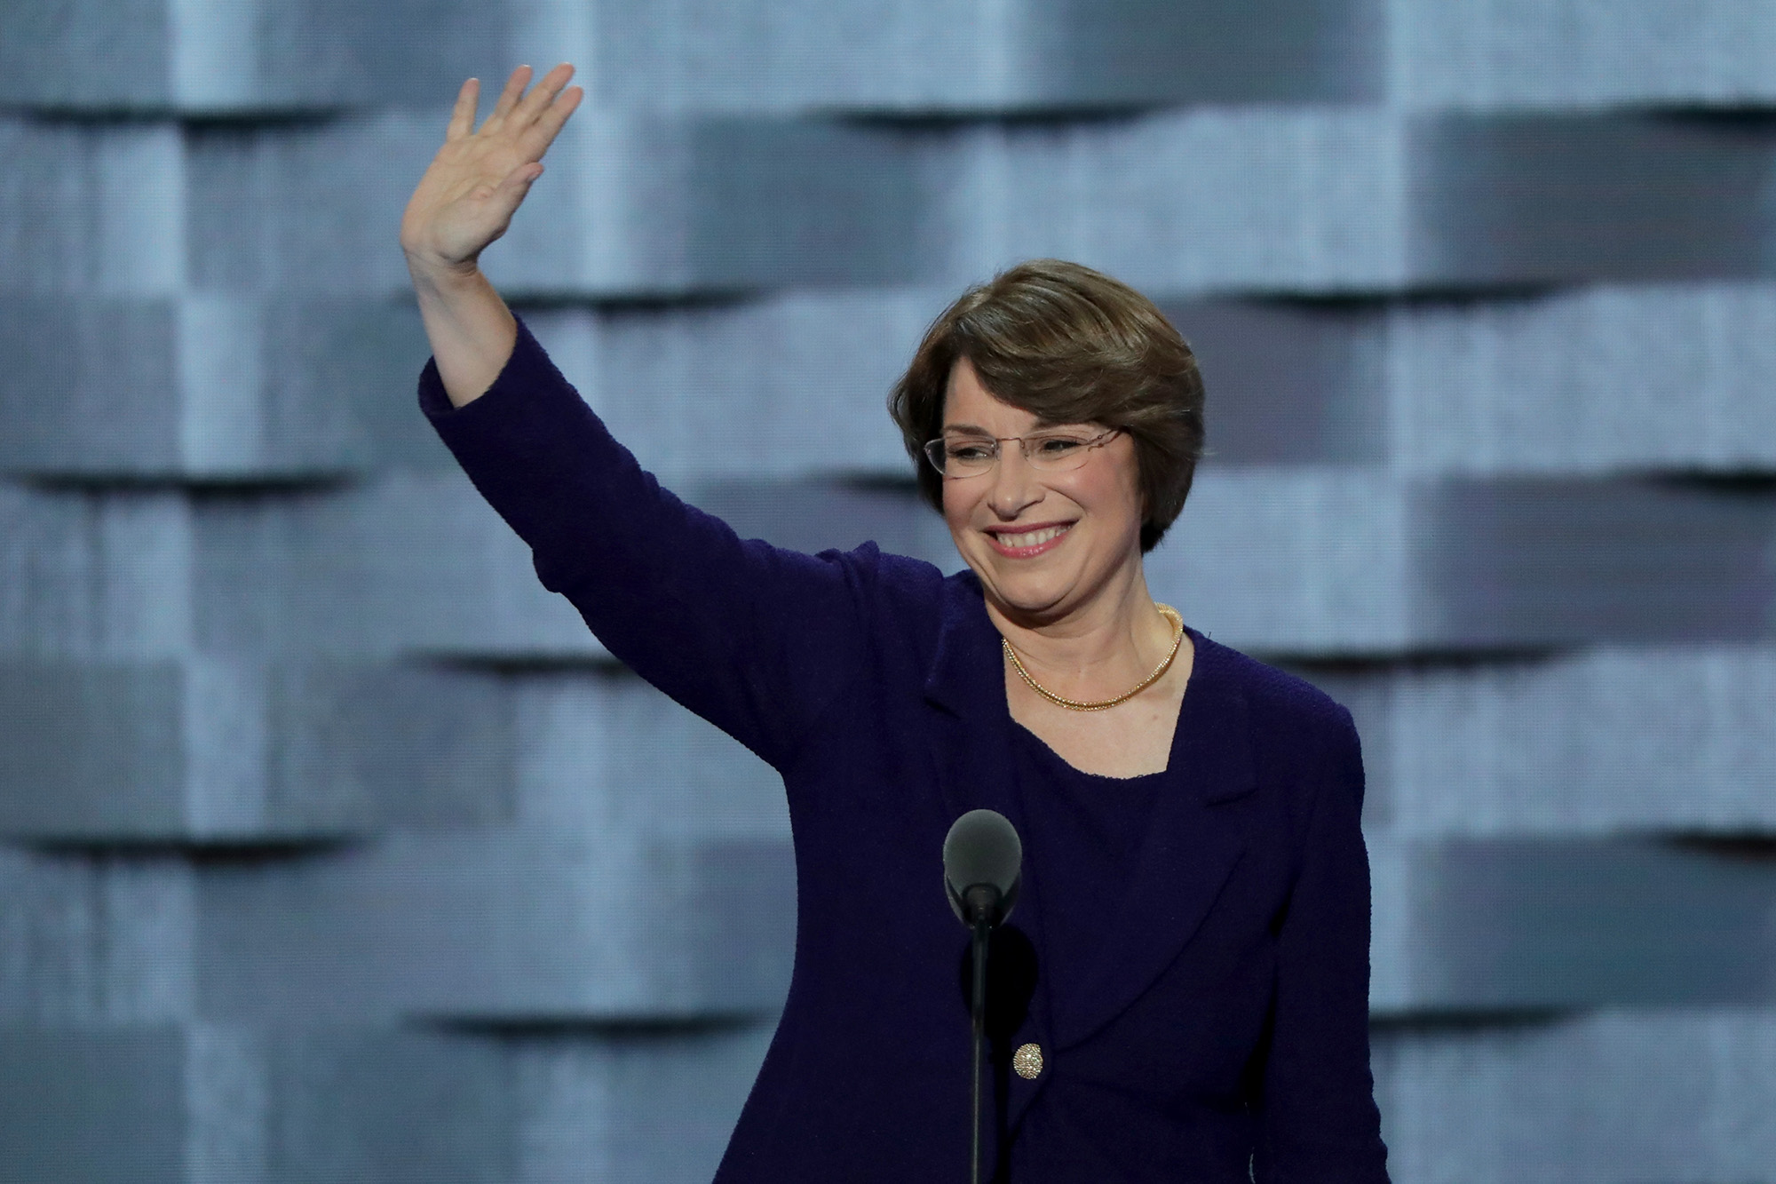
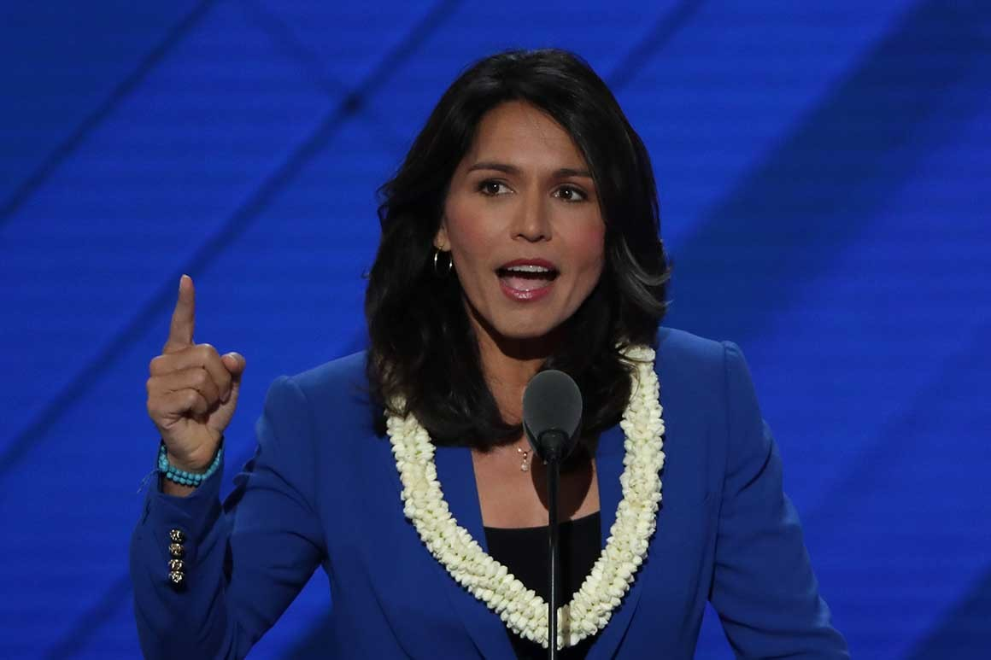
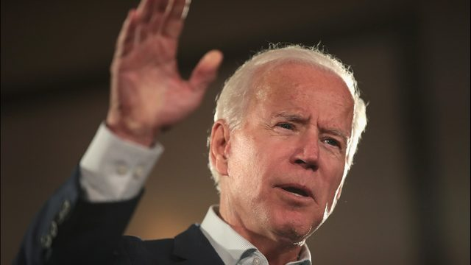
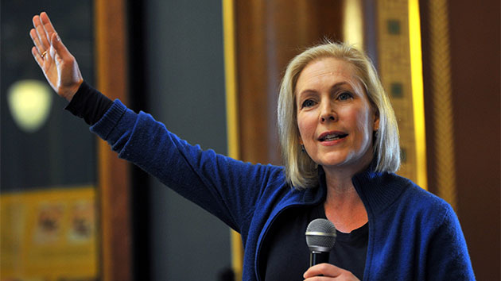
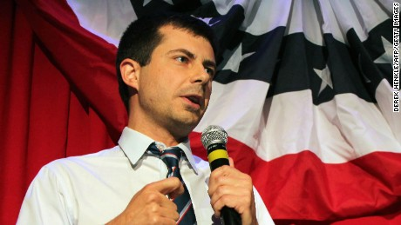
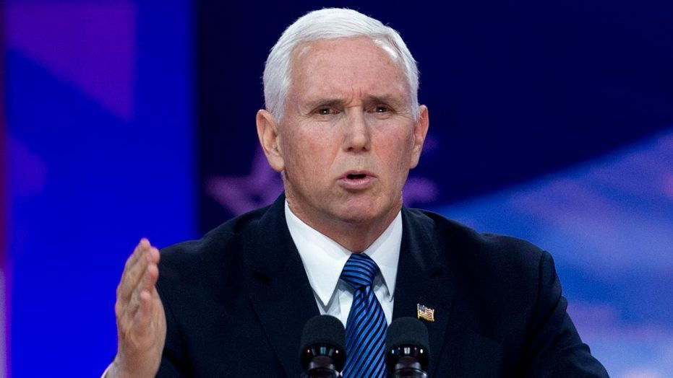
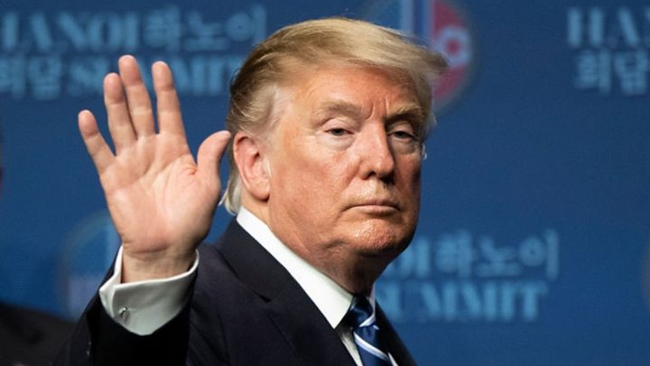
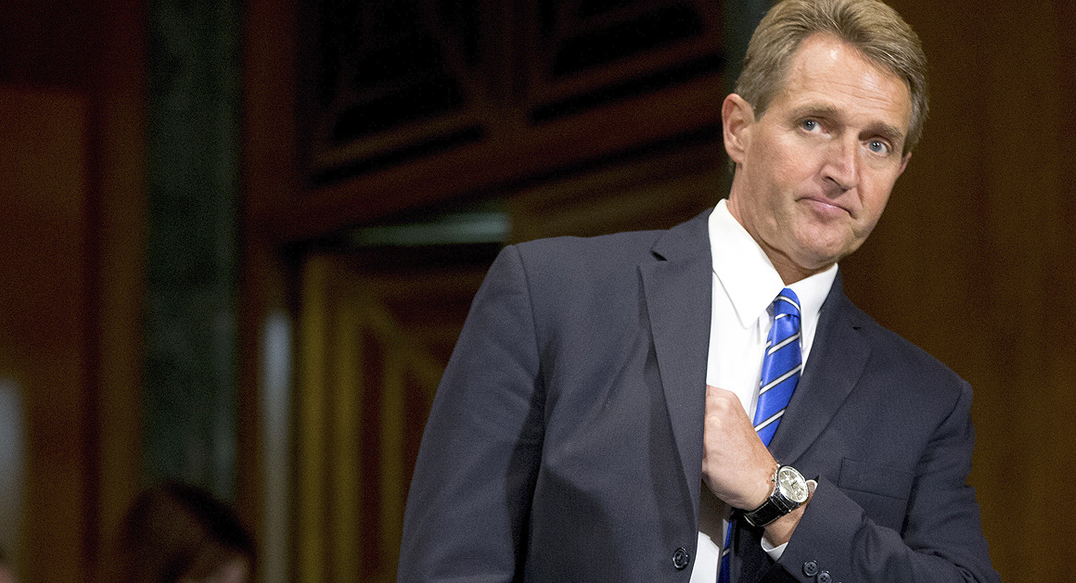
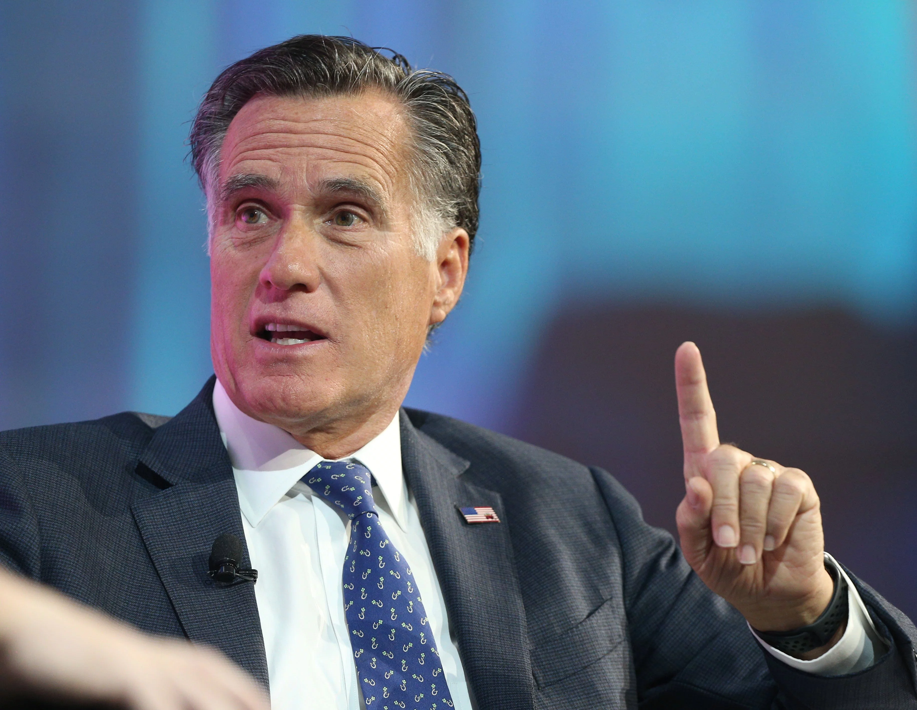
LOOKING AHEAD: THE 2020 PRESIDENTIAL ELECTION

Slide 8
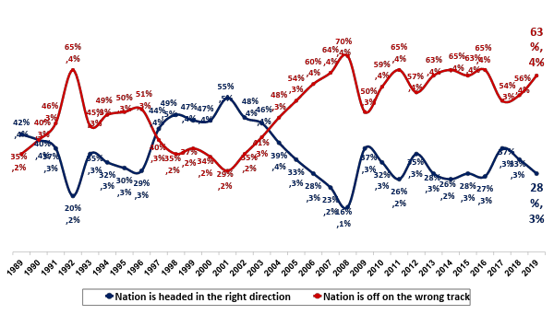
Right Direction/Wrong Track – Yearly Trend
Yearly Averages
GHW Bush
Clinton
GW Bush
Obama
Trump
Notes:
Q.4
Feb. subgroups from 9507b
I feel like there isn’t enough room on this slide for subgroups

Slide 9
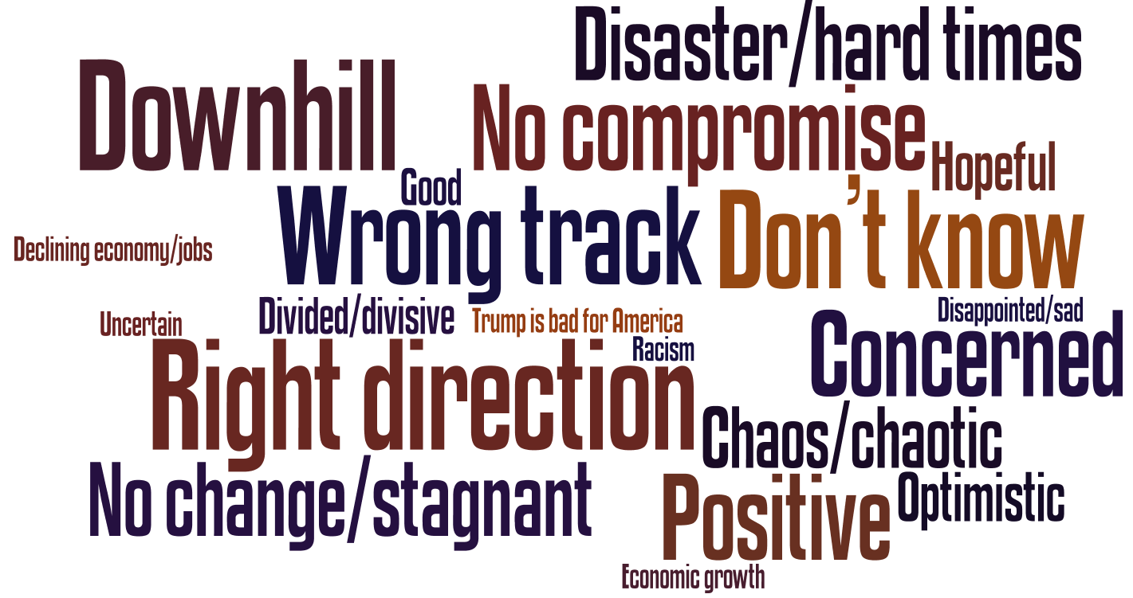
Words to Describe How You Feel About Where America is Headed in the Next Year

Slide 10
Trump Job Approval, by Party
Approval Rating
Notes:
(BKR) Q4

Slide 11
Trump Job Rating By Groups to Watch
 | Approve | Disapprove | Differential | Approve | Disapprove | Differential
SWING GROUPS
Suburban women | 44% | 55% | -11 | 39% | 57% | -18
Independents | 43% | 51% | -8 | 36% | 54% | -18
Moderates | 35% | 63% | -28 | 37% | 59% | -22
DEMOCRATIC GROUPS
18-34 | 41% | 57% | -16 | 35% | 60% | -25
African Americans | 12% | 88% | -76 | 13% | 80% | -67
Hispanics | 34% | 64% | -30 | 24% | 71% | -47
Urban | 31% | 67% | -36 | 30% | 66% | -36
Democrats | 8% | 91% | -83 | 9% | 89% | -80
Postgrad | 33% | 66% | -33 | 27% | 69% | -42
White College edu + Women | 36% | 64% | -28 | 35% | 60% | -25
REPUBLICAN GROUPS
Non-college white men | 66% | 29% | +37 | 66% | 30% | +36
Rural | 60% | 36% | +24 | 65% | 31% | +34
Republicans | 88% | 10% | +78 | 85% | 12% | +73
White men 50+ | 65% | 33% | +32 | 59% | 40% | +19
February 2019
March 2019
Notes:
(BKR) Q4

Slide 12
Donald Trump’s Job Rating After Major Events
Overall Job Rating
44%
40%
39%
40%
41%
39%
44%
44%
43%
43%
46%
9%
38%
86%
7%
30%
82%
7%
35%
82%
6%
35%
82%
6%
39%
85%
8%
33%
78%
12%
36%
87%
12%
36%
87%
8%
41%
85%
5%
39%
86%
8%
43%
88%
Source: NBC/WSJ

Slide 13
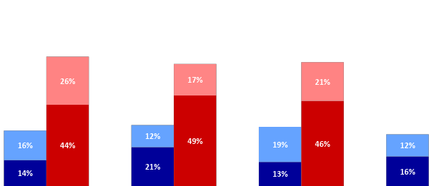
Confidence in Donald Trump
“How confident are you that Donald Trump has the right set of … to be president of the United States?”
Extremely confident
Quite confident
Only somewhat confident
Not at all confident
Goals and policies
Personal characteristics
70%
71%
66%
67%
21%
30%
33%
32%
28%
50%
January 2017
January 2019
January 2017
January 2019
Notes:
(CC) Q11/Q12
Jan 2017: 9507a

Slide 14
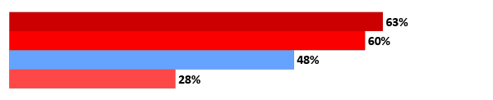

Presidential Qualities: A Comparison to Other Presidents
At Similar Points in Their Presidencies
Being honest and trustworthy
H. W. Bush (Nov. 1989) *
G. W. Bush (Jan. 2003)**
Obama (Dec. 2010) **
Trump (Jan. 2019)
Being knowledgeable and experienced enough to handle the presidency
G. W. Bush (Jan. 2002)
Obama (Dec. 2010)
Trump (Jan. 2019)
* Worded as “Honest/a person you can trust”
** Worded as “Being honest and straightforward”
Notes:
(RP) Q14
Obama Dec 2010 – 9500l
HW Bush Nov 1989 – 4001 NBC scans pg 108
GW Bush Jan 2002 - 6023
GW Bush Jan 2003 - 6030

Slide 15
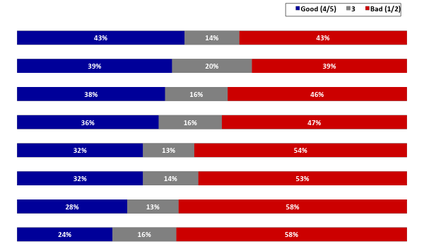
Rating Donald Trump on Qualities
Now, how would you rate Donald Trump on the following qualities, using a five-point scale, on which a "5" means a very good rating, a "1" means a very poor rating, and a "3" means a mixed rating?
Being direct and straightforward in communicating with the American people
Changing business as usual in Washington
Being effective and getting things done
Being a good negotiator
Being knowledgeable and experienced enough to handle the presidency
Being steady and reliable
Being honest and trustworthy
Having high personal and ethical standards
Notes:
(RP) Q14
Trend from FI

Slide 16
Swing Groups’ Feelings About Trump Running For President
Enthus./Comf. –
Some res./
Very uncomf.
All
-19
Moderates
-48
Independents
-29
Suburban Women
-31
Notes:
(BKR) Q10

Slide 17
Most do not believe that the Mueller Report clears Trump.
Does not clear – Clears Trump
+11
+1
+19
+11
+13
-5
+44
-15
+9
Notes:
(RP) Q27

Slide 18
Doubts from Investigation by Media Consumption
 | Major Doubts | Total More Doubts | No More Doubts
Total | 27% | 45% | 48%
Liberal Media | 55% | 76% | 18%
MSNBC | 50% | 69% | 24%
CNN | 42% | 63% | 31%
Broadcast News | 32% | 54% | 38%
Fox | 16% | 28% | 65%
Conservative Media | 2% | 5% | 90%

Slide 19
Seen, Read, or Heard Over Time
Seen, Read, or Heard (S/R/H) | Poll | Date | Total | A Lot
Terrorist Attack at Orlando Nightclub | NBC/WSJ | June 2016 | 99% | 76%
Spread of Ebola in West Africa | NBC/WSJ | Oct. 2014 | 98% | 70%
Ebola Patient in Dallas | NBC/WSJ | Oct. 2014 | 97% | 68%
Trump Access Hollywood Videotape | NBC/WSJ | Mid-Oct 2016 | 95% | 66%
ISIS Beheadings | NBC/WSJ | Sept. 2014 | 94% | 59%
Trump decision to fire Comey | NBC/WSJ | May 2017 | 93% | 56%
Trayvon Martin Shooting | NBC/WSJ | Apr. 2012 | 91% | N/A
Town Hall Protests Against ACA | NBC/WSJ | Aug. 2009 | 85% | N/A
Paul Manafort being found guilty of tax/ bank fraud charges | NBC/WSJ | Aug. 2018 | 84% | 46%
Healthcare.gov Problems | NBC/WSJ | Oct. 2013 | 83% | 59%
Michael Cohen pleading guilty to campaign finance charges | NBC/WSJ | Aug. 2018 | 80% | 46%
Occupy Wall Street | NBC/WSJ | Oct. 2011 | 80% | 40%
Christie Staff Bridge Allegations | NBC/WSJ | Jan. 2014 | 79% | 48%
Obama Immigration Policy | NBC/WSJ | June 2012 | 79% | 38%
Reported Syrian Chem. Weapon Use | NBC | Aug. 2013 | 79% | 35%
SCOTUS Healthcare Decision (NFIB v. Sebelius) | NBC/WSJ | July 2012 | 78% | 43%
Robert Mueller submitting final report on Russia’s interference in 2016 elections | NBC/WSJ | March 2019 | 78% | 39%
Notes:
Q16c

Slide 20



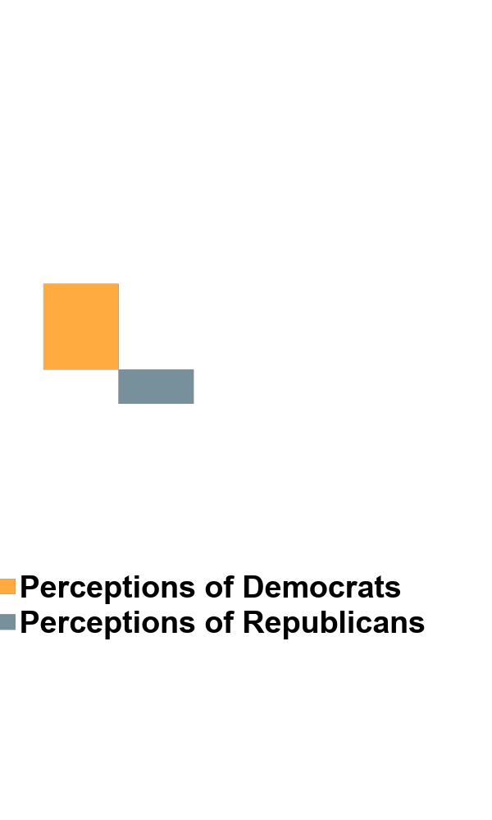

Perceptions of the Parties:
In the Mainstream – Out of the Mainstream
Among Adults Overall
(in the mainstream minus outside the mainstream)
Climate
Change
Health
Care
Abortion
Immigration
Fiscal
Issues
+21
+18
+10
+10
0
-1
-4
-11
-16
-34
Notes:
(RP) Q14/15

Slide 21
Are You Telling Me Democrats Win?
NOW --The Rest of the Story

Slide 22
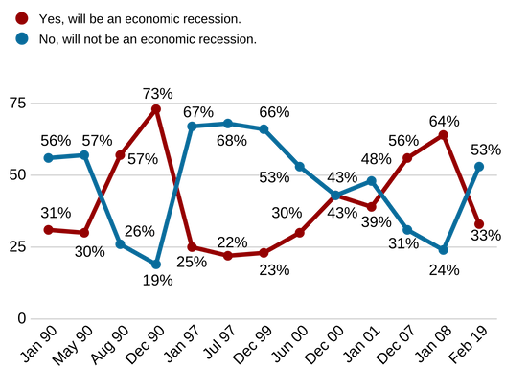
Economic Recession in Next Year? – Trend
Note: Shaded areas are actual economic recession periods.
(July 1990-March 1991, March 2001-November 2001, December 2007-June 2009)
Notes:
Q.4
Feb. subgroups from 9507b
I feel like there isn’t enough room on this slide for subgroups

Slide 23
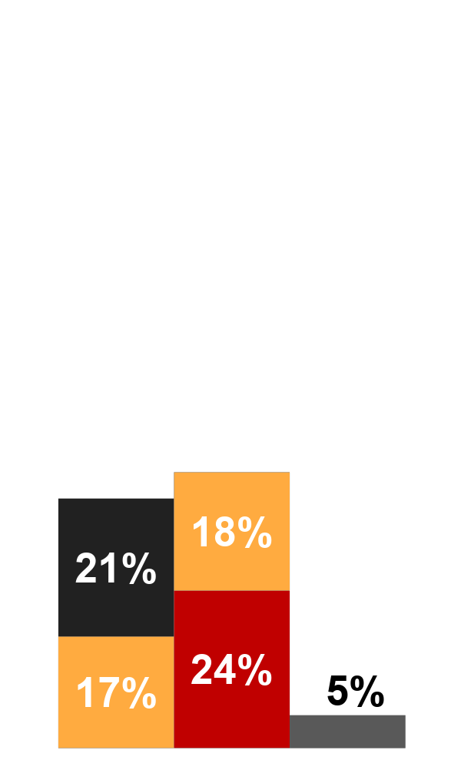
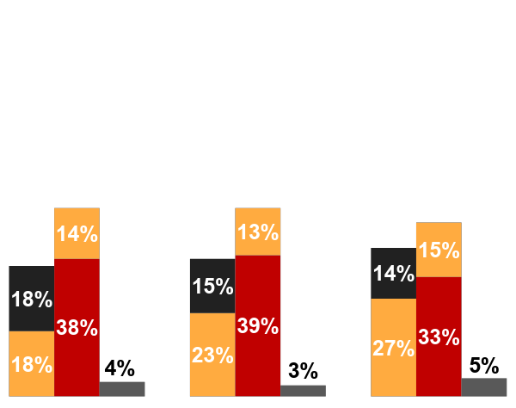
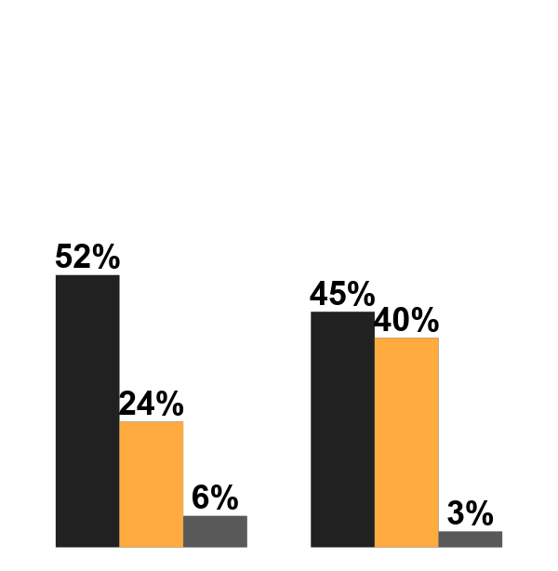
Likelihood to Vote for Trump in 2020
Looking ahead to the next election for president, if Donald Trump runs for reelection as the Republican candidate, will you definitely vote for Trump in that election, probably vote for Trump, probably vote for the Democratic candidate, or definitely vote for the Democratic candidate?
Definitely vote for incumbent
Probably vote for incumbent
Definitely vote for opposition
Probably vote for opposition
Not sure
Incumb.
72%
39%
7%
Oppo.
14%
22%
81%
Incumb.
25%
45%
86%
Oppo.
50%
21%
2%
Incumb.
84%
38%
7%
Oppo.
9%
35%
78%
Incumb.
2%
30%
84%
Oppo.
91%
47%
9%
Incumb.
2%
25%
85%
Oppo.
96%
49%
8%
Incumb.
5%
24%
87%
Oppo.
90%
41%
7%
Dem.
Indep.
Rep.
Dem.
Indep.
Rep.
Dem.
Indep.
Rep.
Dem.
Indep.
Rep.
Dem.
Indep.
Rep.
Dem.
Indep.
Rep.
52%
52%
48%
42%
41%
38%
36%
38%
Bill Clinton
Jan. 1995
G.W. Bush
April 2003
Barack Obama
Feb. 2011
Donald Trump
Dec. 2017
Donald Trump
Dec. 2018
Donald Trump
Feb. 2019
Notes:
CC Q7
Obama- 9501b
Bush- 6034
Dec 18- 9508k
Dec 17- 9507l
Clinton – 4056-7a

Slide 24
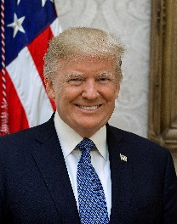
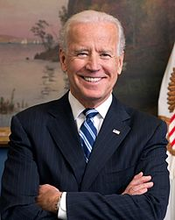
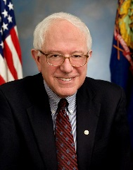
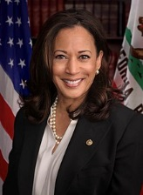
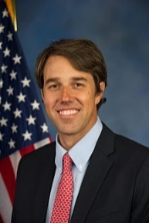
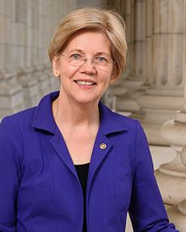
2020 Candidate Support
Ranked by % Enthusiastic | Enthusiastic | Enthusiastic/ Comfortable | Reservations/ Uncomfortable | Net Difference (Enthus/Comf - Res/Uncomf)
Donald Trump (0% unable to rate) | 26% | 40% | 59% | -19%
Joe Biden (4% unable to rate) | 17% | 47% | 48% | -1%
Bernie Sanders (3% unable to rate) | 14% | 37% | 58% | -21%
Kamala Harris (30% unable to rate) | 9% | 25% | 41% | -16%
Beto O’Rourke (33% unable to rate) | 8% | 23% | 41% | -18%
Elizabeth Warren (15% unable to rate) | 8% | 30% | 53% | -23%

Slide 25
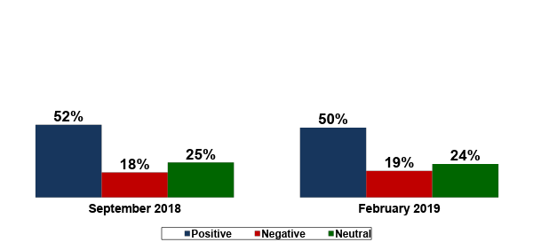
Capitalism Feeling Thermometer
GOP | 70% | 13%
IND | 51% | 13%
DEM | 40% | 22%
GOP | 71% | 10%
IND | 40% | 23%
DEM | 36% | 27%
+34% | +31%

Slide 26
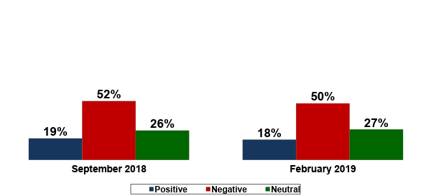
Socialism Feeling Thermometer
GOP | 6% | 83%
IND | 12% | 50%
DEM | 33% | 27%
GOP | 6% | 79%
IND | 9% | 52%
DEM | 31% | 25%
-33% | -32%

Slide 27
Democratic Party Presidential Nominee
In selecting a presidential nominee for the Democratic Party, which of the following is most important to you?
 | Among Democratic Primary Voters | Candidate with the best chance to defeat Trump | Candidate who comes closes to your views on issues
 | All Democrats | 39% | 57%
 | Dem Primary Voters | 40% | 56%
 | Dem Primary Voters History | 43% | 53%
Democratic Primary Voters | Men | 42% | 55%
 | Women | 39% | 56%
 | 18-49 | 32% | 65%
 | 50+ | 48% | 48%
 | Strong Dem | 45% | 51%
 | Lean Dem | 27% | 70%
 | Liberals | 43% | 51%
 | Moderates/Conservatives | 36% | 62%
 | Whites | 42% | 53%
 | Non-Whites | 35% | 62%
 | Issues: Larger Scale | 39% | 57%
 | Issues: Small Scale | 43% | 54%

Slide 28
Two Democratic Candidate Options
In thinking about how the eventual Democratic nominee for president in 2020 approaches issues like health care, climate change, college affordability, and economic opportunity, which of the following comes closer to describing the candidate you prefer?
 | Among Democratic Primary Voters | Someone who proposes larger scale policies that cost more and might be harder to pass into law, but will bring major change | Someone who proposes smaller scale policies that cost less and might be easier to pass into law, but will bring less change
 | All Democrats | 56% | 40%
 | Dem Primary Voters | 55% | 42%
Democratic Primary Voters | Men | 50% | 46%
 | Women | 57% | 40%
 | 18-49 | 60% | 40%
 | 50+ | 49% | 45%
 | Strong Dem | 59% | 38%
 | Lean Dem | 51% | 46%
 | Liberals | 63% | 33%
 | Moderates/Conservatives | 45% | 53%
 | Whites | 51% | 45%
 | Non-Whites | 61% | 38%
 | Nominee: Defeat Trump | 54% | 45%
 | Nominee: Agree on Issues | 56% | 41%

Slide 29
2020

Slide 30
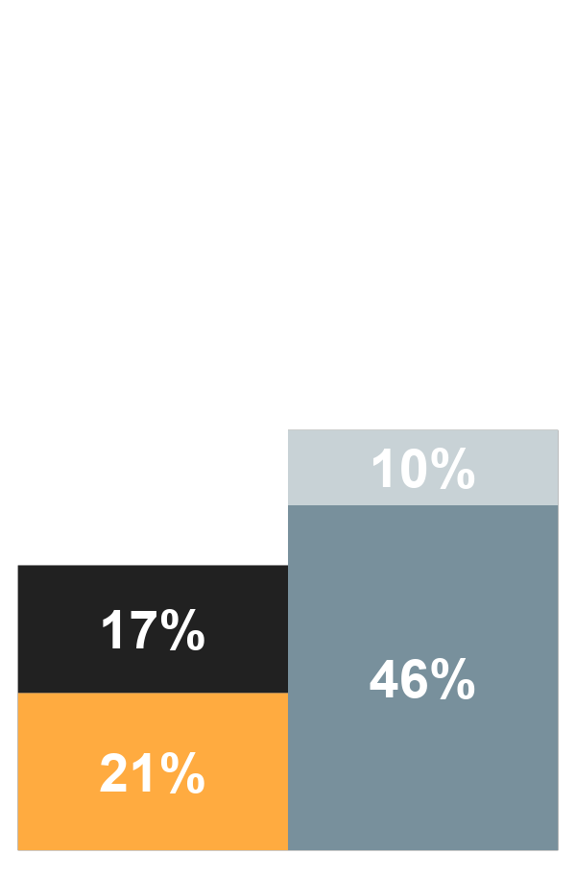
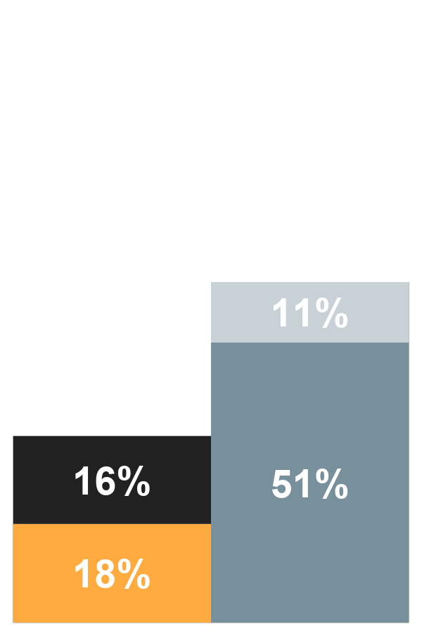
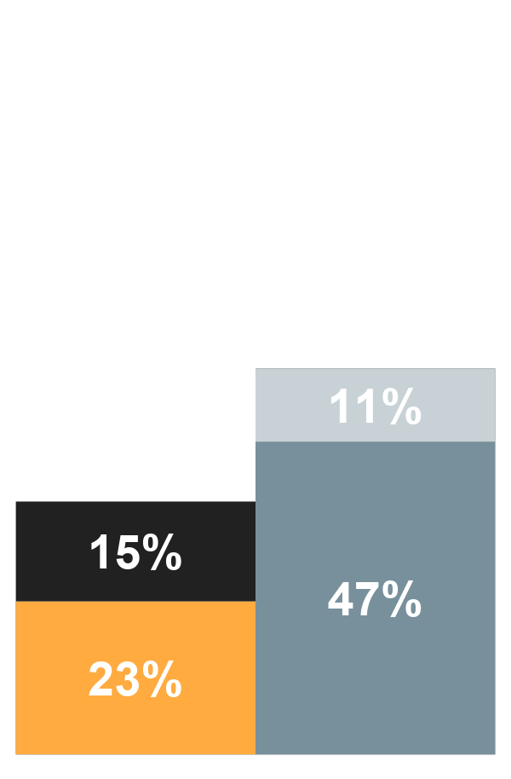
Attitudes about Donald Trump’s honesty related to the investigation Russian interference remain skeptical but unchanged.
“
Donald Trump has been honest and truthful when it comes to the investigation into Russian interference with the 2016 presidential election and related matters.”
Strongly agree
Somewhat agree
Somewhat disagree
Strongly disagree
62%
56%
58%
38%
37%
34%
August 2018
December 2018
February 2019
Notes:
(JH) Q23
August: quickie tabs saved in 9508f

Slide 31
Reservations/Uncomfortable with a Candidate Who is…
Top Five Attributes Reservations/Uncomfortable by Party
Republicans | Independents | Democrats
A Socialist (93%) | A Socialist (74%) | A Business Executive (68%)
A Muslim (70%) | Someone Over Age 75 (61%) | Someone Over Age 75 (67%)
Someone Over Age 75 (57%) | An Evangelical Christian (52%) | An Evangelical Christian (60%)
Someone Under Age 40 (51%) | A Business Executive (48%) | A Socialist (52%)
A Person Who is Gay or Lesbian (43%) | A Muslim (44%) | A Person Running as an Independent (49%)

Slide 32
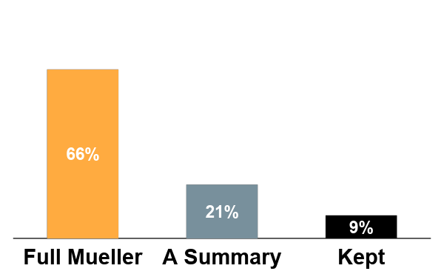
But Americans are clear in their desire for the full Mueller Report to be released.
When Special Counsel Robert Mueller finishes the investigation into Russian interference with the 2016 presidential election and related matters, he is required to submit his findings to the U.S. Attorney General, who is a member of President Trump’s cabinet. Do you think …
Mueller’s full report should be released to the public
A summary of Mueller’s report prepared by the Attorney General should be released to the public
Report should not be released to the public and be kept confidential
 | Full Report Released | Summary | Kept Confidential
Democrats | 80% | 14% | 5%
Independents | 69% | 19% | 8%
Republicans | 52% | 28% | 14%
GOP: Support Trump | 54% | 25% | 15%
GOP: Support Party | 52% | 33% | 11%
Notes:
Q24 (JH)

Slide 33
The Impeachment Factor
Nixon & Clinton
Q: Do you think President Nixon should be impeached and compelled to leave the presidency, or not? | Q: As you may know, removing a president from office involves two major steps in Congress. First, the House of Representatives must vote on whether there is enough evidence to bring a president to trial before the Senate. This step is called impeachment. Next, the Senate must vote on whether to remove the president from office or not.
June 1973 | December 1998
19% | 35%

Slide 34
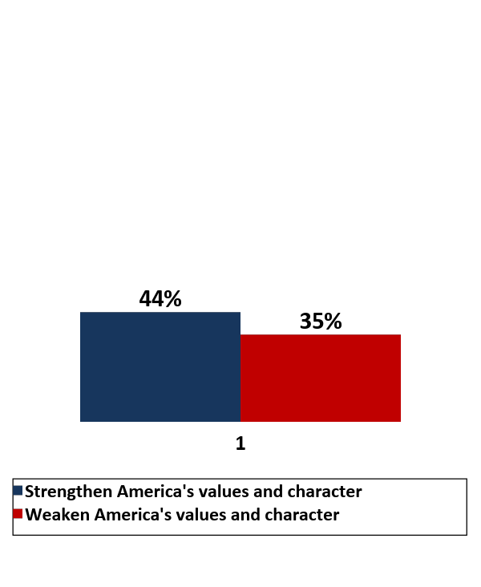
Southern Border Immigrants
 | Strengthen America | Weaken America
18-34 | 52% | 24%
35-49 | 44% | 34%
50-64 | 38% | 42%
65+ | 37% | 42%
Republicans | 18% | 61%
Independents | 46% | 34%
Democrats | 67% | 12%
2016 Trump Voters | 15% | 66%
2016 Clinton Voters | 69% | 9%
GOP Support Trump | 11% | 70%
GOP Support Party | 28% | 51%
Broadcast News | 48% | 32%
Fox | 28% | 52%
CNN | 54% | 24%
MSNBC | 58% | 21%
Conservative Media | 12% | 71%
Liberal Media | 67% | 12%
In general, when it comes to America’s values and character, do you think the people coming to our Southern border with Mexico who want to immigrate to America will….
+9%

Slide 35
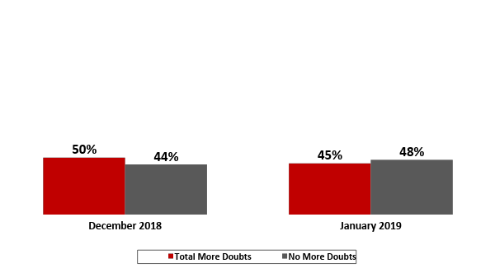
Doubts about Trump from Investigation
Based on what you have been seen, read, or heard about Special Prosecutor Robert Mueller’s investigation, has it given you more doubts about Donald Trump's presidency or not?
-6% | +3%
31%
Very Major Doubts
27%
Very Major Doubts

Slide 36
Confidence in Donald Trump
“How confident are you that Donald Trump has the right set of … to be president of the United States?”
Extremely confident
Quite confident
Only somewhat confident
Not at all confident
Goals and policies
Personal characteristics
70%
71%
66%
67%
30%
33%
32%
28%
January 2017
January 2019
January 2017
January 2019
Notes:
(CC) Q11/Q12
Jan 2017: 9507a

Slide 37
Reservations/Uncomfortable with a Candidate Who is…
Top Five Attributes Reservations/Uncomfortable by Party
Republicans | Independents | Democrats
A Socialist (93%) | A Socialist (74%) | A Business Executive (68%)
A Muslim (70%) | Someone Over Age 75 (61%) | Someone Over Age 75 (67%)
Someone Over Age 75 (57%) | An Evangelical Christian (52%) | An Evangelical Christian (60%)
Someone Under Age 40 (51%) | A Business Executive (48%) | A Socialist (52%)
A Person is Gay or Lesbian (43%) | A Muslim (44%) | A Person Running as an Independent (49%)

Slide 38
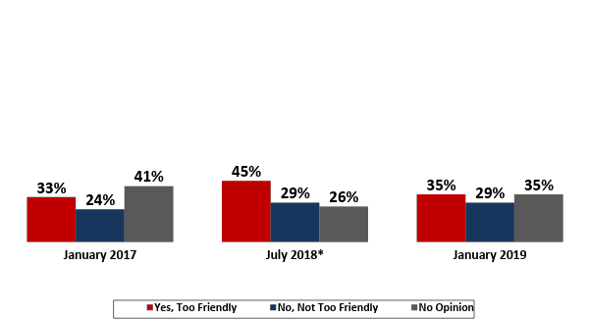
Trump’s Relationship with Putin
In general, do you believe that Donald Trump has a relationship with Vladimir Putin that is too friendly therefore not appropriate, not too friendly with the president of Russia or do you not have an opinion on this?
GOP | 7% | 44% | 46%
IND | 20% | 25% | 53%
DEM | 63% | 7% | 29%
GOP | 11% | 58% | 30%
IND | 47% | 19% | 33%
DEM | 79% | 6% | 17%
GOP | 7% | 58% | 34%
IND | 25% | 26% | 47%
DEM | 68% | 6% | 26%
-9% | -16% | -6%
*Among RVs

Slide 39
Seen, Read, or Heard Over Time
Seen, Read, or Heard (S/R/H) | Poll | Date | Total | A Lot
Terrorist Attack at Orlando Nightclub | NBC/WSJ | June 2016 | 99% | 76%
Spread of Ebola in West Africa | NBC/WSJ | Oct. 2014 | 98% | 70%
Ebola Patient in Dallas | NBC/WSJ | Oct. 2014 | 97% | 68%
Trump Access Hollywood Videotape | NBC/WSJ | Mid-Oct 2016 | 95% | 66%
ISIS Beheadings | NBC/WSJ | Sept. 2014 | 94% | 59%
Trump decision to fire Comey | NBC/WSJ | May 2017 | 93% | 56%
Trayvon Martin Shooting | NBC/WSJ | Apr. 2012 | 91% | N/A
Town Hall Protests Against ACA | NBC/WSJ | Aug. 2009 | 85% | N/A
Paul Manafort being found guilty of tax/ bank fraud charges | NBC/WSJ | Aug. 2018 | 84% | 46%
Healthcare.gov Problems | NBC/WSJ | Oct. 2013 | 83% | 59%
Michael Cohen pleading guilty to campaign finance charges | NBC/WSJ | Aug. 2018 | 80% | 46%
Occupy Wall Street | NBC/WSJ | Oct. 2011 | 80% | 40%
Christie Staff Bridge Allegations | NBC/WSJ | Jan. 2014 | 79% | 48%
Obama Immigration Policy | NBC/WSJ | June 2012 | 79% | 38%
Reported Syrian Chem. Weapon Use | NBC | Aug. 2013 | 79% | 35%
SCOTUS Healthcare Decision (NFIB v. Sebelius) | NBC/WSJ | July 2012 | 78% | 43%
Robert Mueller submitting final report on Russia’s interference in 2016 elections | NBC/WSJ | March 2019 | 78% | 39%
Notes:
Q16c

Slide 40
Most do not believe that the Mueller Report clears Trump.
Does not clear – Clears Trump
+11
+1
+19
+11
+13
-5
+44
-15
+9
Notes:
(RP) Q27

Slide 41
Role of Government – Trend
Statement A: Government should do more to solve problems and help meet the needs of people.
Statement B: Government is doing too many things better left to businesses and individuals.
Clinton
Bush 43
Obama
Trump
Notes:
Q.4
Feb. subgroups from 9507b
I feel like there isn’t enough room on this slide for subgroups

