Slide 1
The POTW View on PFAS
Cynthia A. Finley, Ph.D.
Director, Regulatory Affairs
National Association of Clean Water Agencies (NACWA)
2019 NASF Washington Forum
April 16, 2019

Slide 2

NACWA: A Clear Commitment to Our Nation’s Waters
National trade association for public wastewater & stormwater utilities
Represent over 300 public utilities of all sizes from around the country (15 in Texas)
Leader in legislative, regulatory and legal advocacy on the full spectrum of clean water issues

Slide 3
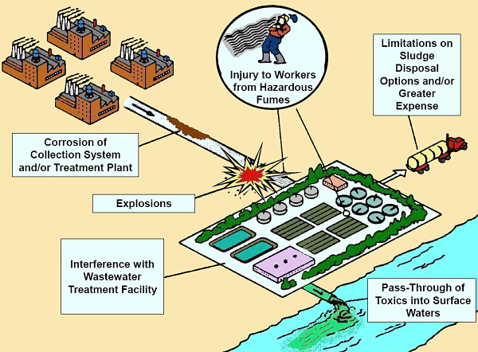
POTW Pretreatment Programs
Diagram from Michigan DEQ

Slide 4

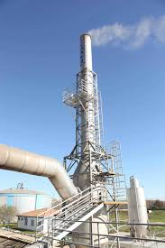
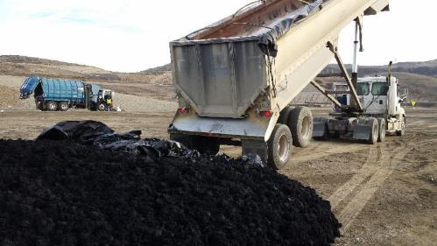
Biosolids Management
Land Application Landfill Incineration

Slide 5
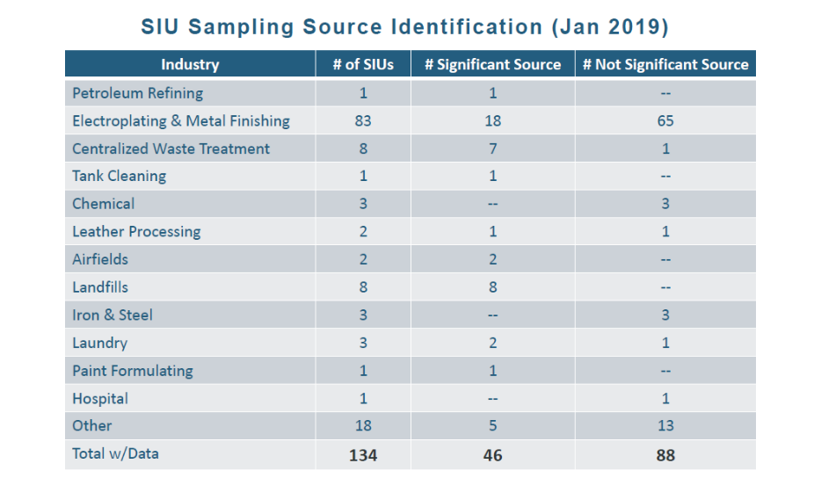
PFAS Sources – Industrial Users

Slide 6






PFAS Sources – Domestic

Slide 7

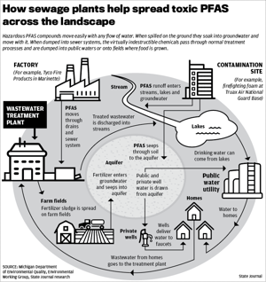
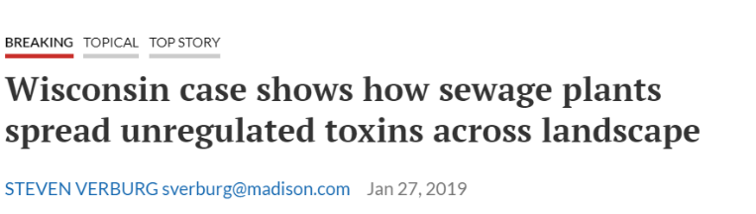

PFAS & POTWs in the News
“As Wisconsin discovers more PFAS contamination it will decide whether to follow the lead of Michigan and investigate the role of wastewater treatment plants in spreading the indestructible, toxic compounds across the landscape.”

Slide 8

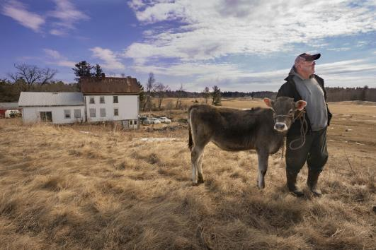
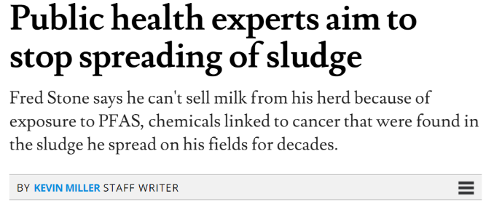
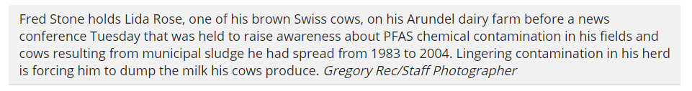
Maine
Notes:
Pruitt came to Washington as an outsider and aspiring politician; Mr. Wheeler is viewed as a Washington insider who avoids the limelight and has spent years effectively navigating the rules.
SAME AGENDA, BUT MORE EFFECTIVE
he does believe people have an impact on climate. But when it comes to rewriting regulations for greenhouse gases he will put forward suggestions that stay within the laws passed by Congress.
Wheeler worked at EPA from 91-95 - special assistant to the Information Management Division Director in EPA’s Office of Pollution Prevention and Toxics working on toxic chemical, pollution prevention, and right-to-know issues.

Slide 9

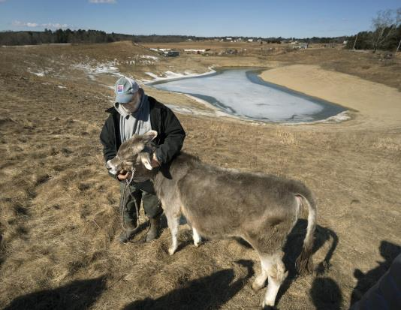
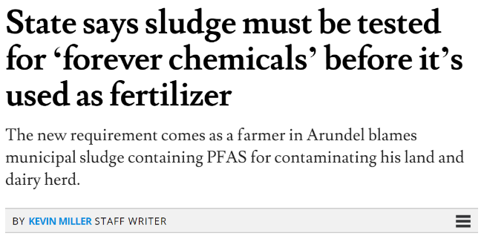
Maine
Notes:
Pruitt came to Washington as an outsider and aspiring politician; Mr. Wheeler is viewed as a Washington insider who avoids the limelight and has spent years effectively navigating the rules.
SAME AGENDA, BUT MORE EFFECTIVE
he does believe people have an impact on climate. But when it comes to rewriting regulations for greenhouse gases he will put forward suggestions that stay within the laws passed by Congress.
Wheeler worked at EPA from 91-95 - special assistant to the Information Management Division Director in EPA’s Office of Pollution Prevention and Toxics working on toxic chemical, pollution prevention, and right-to-know issues.

Slide 10
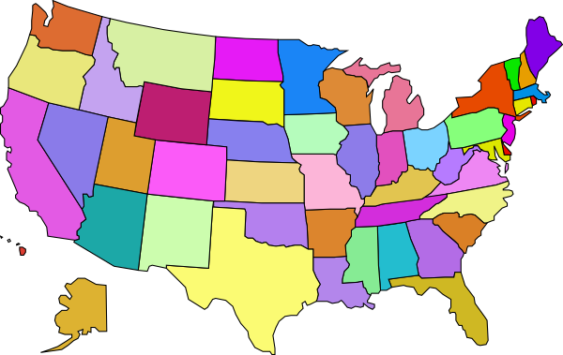
Dealing with a Patchwork Approach
Legislation
Michigan: POTWs asked to evaluate potential sources of PFAS and reduce/eliminate sources found
Maine: Biosolids must be sampled and tested for PFOA, PFOS, and PFBS before land application
Washington: PFAS Chemical Action Plan being developed
California: Investigation plan
  Phase 1: airports and landfills
  Phase 2: refineries, fire training areas, wildfire areas
  Phase 2: includes POTWs and “secondary manufacturers”

Slide 11
NACWA Advocacy Priorities
Add protections against PFAS contamination to TSCA requirements
Empower the pretreatment program to control sources
Consider unintended consequences
Close the scientific gaps, especially related to risk
Notes:
Pruitt came to Washington as an outsider and aspiring politician; Mr. Wheeler is viewed as a Washington insider who avoids the limelight and has spent years effectively navigating the rules.
SAME AGENDA, BUT MORE EFFECTIVE
he does believe people have an impact on climate. But when it comes to rewriting regulations for greenhouse gases he will put forward suggestions that stay within the laws passed by Congress.
Wheeler worked at EPA from 91-95 - special assistant to the Information Management Division Director in EPA’s Office of Pollution Prevention and Toxics working on toxic chemical, pollution prevention, and right-to-know issues.

Slide 12

POTW Pretreatment Programs
Understanding sources of PFAS
Building partnerships and collaborative efforts
Participate in effluent guidelines development
Notes:
Pruitt came to Washington as an outsider and aspiring politician; Mr. Wheeler is viewed as a Washington insider who avoids the limelight and has spent years effectively navigating the rules.
SAME AGENDA, BUT MORE EFFECTIVE
he does believe people have an impact on climate. But when it comes to rewriting regulations for greenhouse gases he will put forward suggestions that stay within the laws passed by Congress.
Wheeler worked at EPA from 91-95 - special assistant to the Information Management Division Director in EPA’s Office of Pollution Prevention and Toxics working on toxic chemical, pollution prevention, and right-to-know issues.

Slide 13

Thank you
Cynthia A. Finley, Ph.D.
Director, Regulatory Affairs
National Association of Clean Water Agencies (NACWA)
cfinley@nacwa.org | 202-510-6593

