Slide 1
Per- and Polyfluoroalkyl Substances
Background Information
Janet Anderson, Ph.D., DABT
Integral Consulting, Inc.
April 16, 2019 – NASF Washington Forum

Slide 2
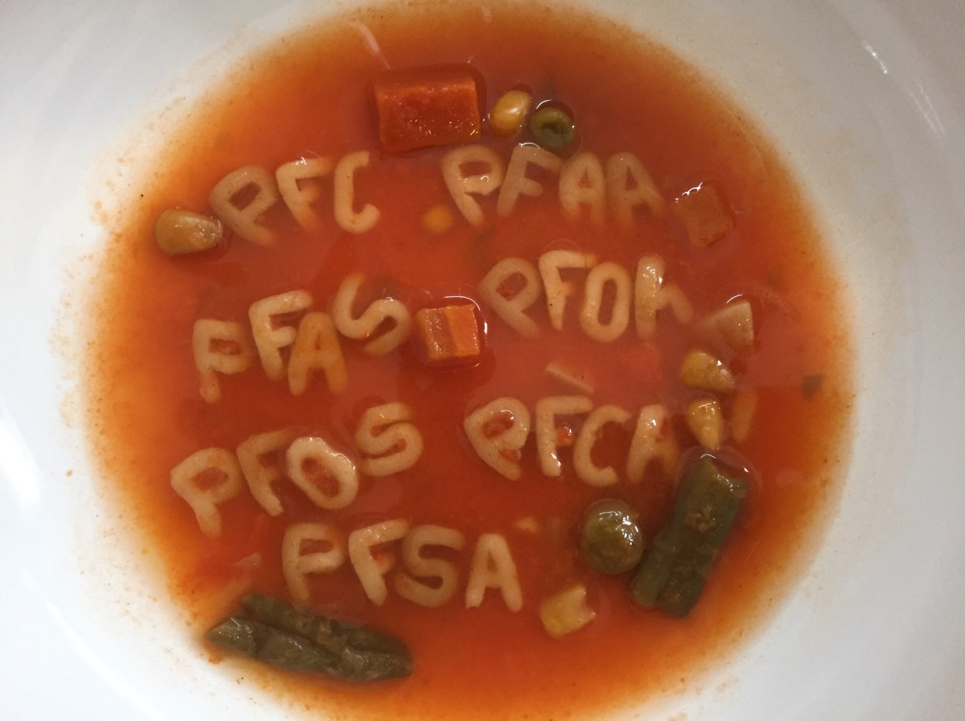
Per- and Polyfluoroalkyl Substances (PFAS)

Slide 3
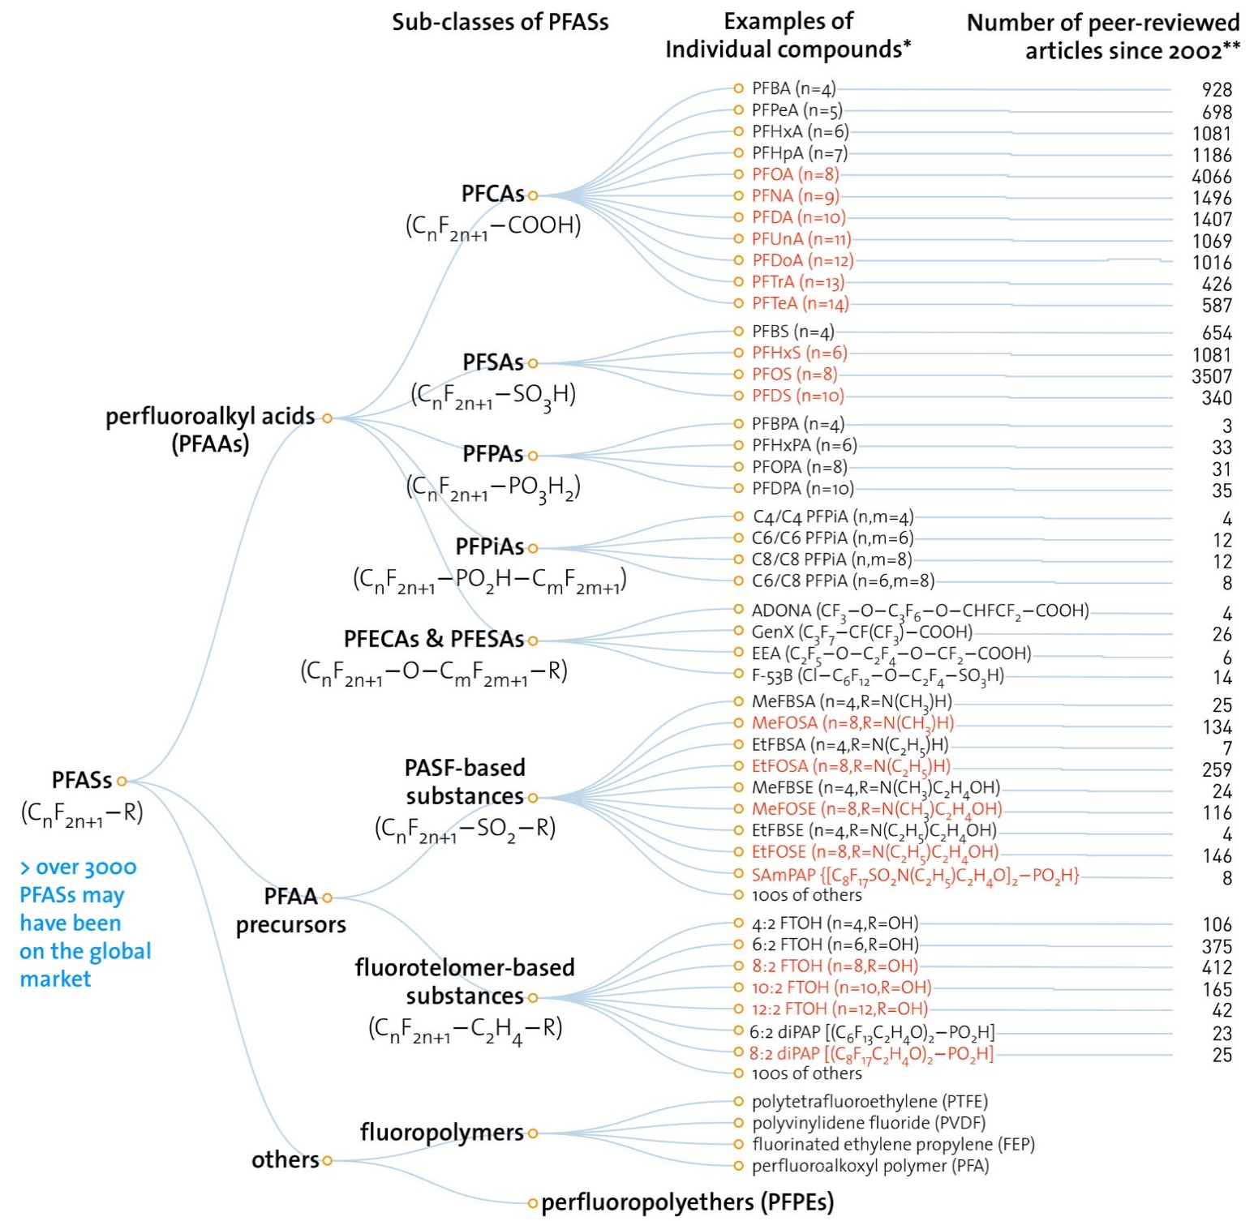
Family Tree of PFAS
Examples of
Individual compounds
Number of peer-reviewed articles since 2002
Complicated nomenclature and chemistries
>4,000 may have been on, or associated with, the on global market
Red = Restricted
Wang et al. (2017)
Notes:
Add nomenclature complicated and move >3000 comment

Slide 4
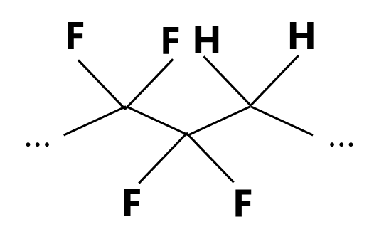
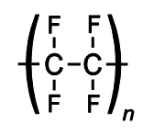
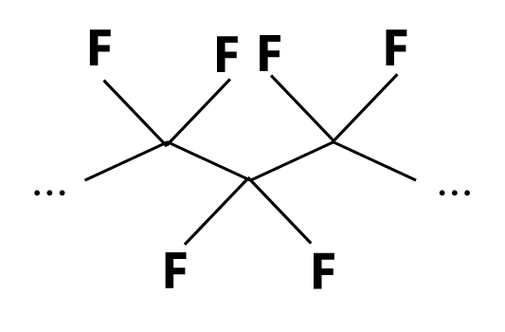
PFAS Chemistry and Nomenclature
Non-Polymers
PFAS = Per- and Polyfluoroalkyl substances
  Two or more carbons joined, plus multiple fluorines
Perfluoroalkyl acids
  “Per” = fully fluorinated
  e.g., PFOS and PFOA
Polyfluoroalkyl substance
  “Poly” = many fluorines
  e.g., 6:2 FTS
  Fluorotelomer sulfonate
polyfluoro
Polymers (e.g., PTFE)
perfluoro
PFAA

Slide 5
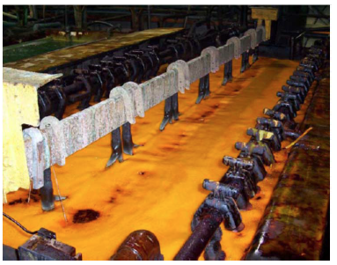

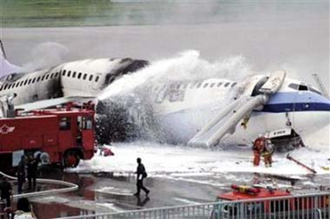


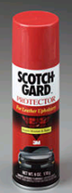



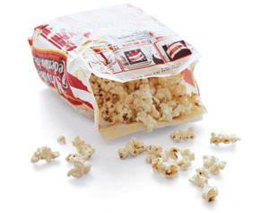
PFAS: Chemical Properties
Heat resistant
Stain resistant
Resistant to biodegradation
C-F strongest bond in nature
Highly sorbent
High surface tension
High water solubility

Slide 6
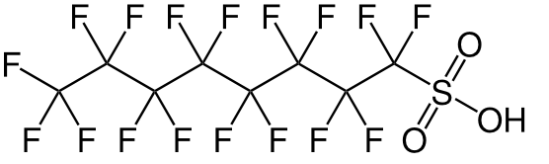
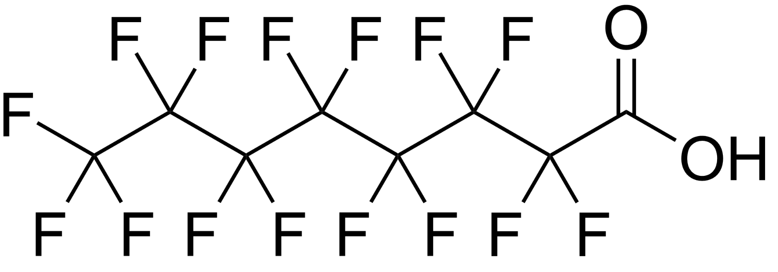
Why the Concern?
PFOS
  3M
  Voluntarily discontinued in 2002
Anthropogenic chemicals with widespread use since the 1940s
Evolving science
Some may be regarded as
  Persistent
  Bioacuumulative
  Toxic
Some appear to be ubiquitous at low levels
PFOA
  Arkema, Asahi, BASF Corporation, Clariant, Daikin, 3M/Dyneon, DuPont, Solvay Solexis
  Voluntarily discontinued ≤2015

Slide 7
Wide-Spread Environmental Occurrence
Some PFAS ubiquitous at low concentrations
High-concentration are typically found near
  Manufacturing facilities
  Military and civilian airports, refineries, and other locations with fuel fires or fuel fire training sites
  Textile mills
  Wastewater treatment plant (WWTP) outfalls
  Biosolids application areas
Image?
Oliaei et al. (2013), Environ Sci Pollut Res

Slide 8
How did we get here?
Switch to “replacement chemistry”
Litigation, regulatory attention, ongoing research
Widespread use in industry
3M Phase-out of PFOS
3M NRDA $850M Settlement
2000-2002
1/2018
DuPont, WV; Leach Settlement
C8 Health Studies Begin
UCMR3
Testing
2004
2013–2015
DuPont Class Action Settlement ($671M)
AFFF
EPA “PFOA Stewardship Program”
2/2017
1969
1/2006
EPA Provisional Health Advisories for DW
EPA PFAS Action Plan
TSCA Chemical Substance Inventory
EPA Lifetime
Health Advisories
2009
TSCA “Long-Chain PFC Action Plan”
2/2019
PFAS Chemical Engineering
5/2016
EPA PFAS Leadership Summit
1979
12/2009
5/2018
PFAS U.S. Timeline of Key Events
1940-50s
1970s
2006
2009
2013
2016
2018
2019
Notes:
Note the Animation on this slide

Slide 9
Per- and Polyfluoroalkyl Substances
Metal Plating and Surface Coating Perspective
Janet Anderson, Ph.D., DABT
Integral Consulting, Inc.
April 16, 2019 – NASF Washington Forum

Slide 10



PFAS are Essential in
Chrome Plating, Etching
Increases quality of plating baths, reduces waste
Results in high corrosion resistance
Wetting and leveling to improve etching process
Improves worker and environmental safety (e.g., hexavalent chrome)
  Suppresses hexavalent chromium vapors by reducing surface tension of solution
  CAA MACT Cr(VI) limits
  OSHA worker safety requirements

Slide 11
Key PFAS U.S. Milestones for NASF
3M Phase-out of PFOS
Industry mtgs with stakeholders (e.g. DoD, EPA Reg 5)
2000-2002
Phase-out of PFOS-based mist suppressants under NESHAP
MN identified metal plating shops as source of PFOS in environment
2018
PFAS used in chromium plating
2012–2015
2007
1954
USEPA Reg 5 PFOS Chromium Electroplating Study
EPA PFAS Action Plan
EPA Lifetime
Health Advisories
2/2019
PFAS Chemical Engineering
2009
5/2016
EPA PFAS Leadership Summit
5/2018
PFAS U.S. Timeline of Key Events
1940-50s
2007
2009
2012-15
2016
2018
2019
Notes:
Animation

Slide 12
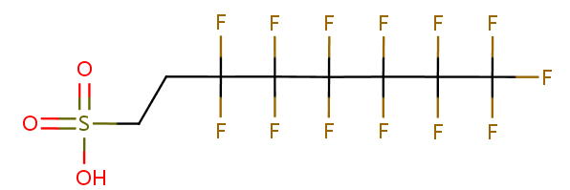
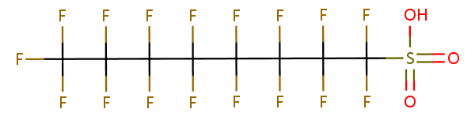
Industry-EPA Collaboration to Ban
PFOS in Chromium Plating
Switch from PFOS (historic) to 6:2 FTS (current, U.S.)
PTFE
Perfluorooctane sulfonate
6:2 Fluoroteolomer sulfonate

Slide 13
Then Why Do We Still Care?
Legacy Environmental Liability
Replacements, Product Stewardship, Best Practices

Slide 14


Interest in PFAS in Industry
Effluent Discharge is Increasing
EPA - study of PFAS in industry discharge (see EPA’s Final 2016 Effluent Guidelines Program Plan, April 2018)
Important discussion topic at the state level
  Minnesota - state-wide testing of WWTP effluent in 2007 (identified local chromium electroplating facility as contributor of PFOS to WWTP)
  Michigan - promulgated PFOS surface water quality standard of 12 ppt

Slide 15
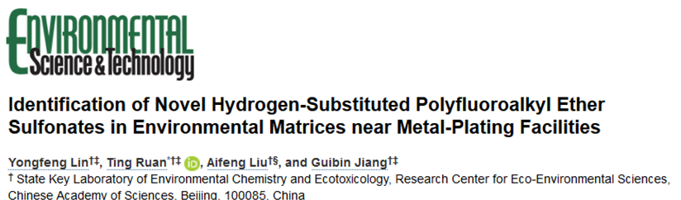
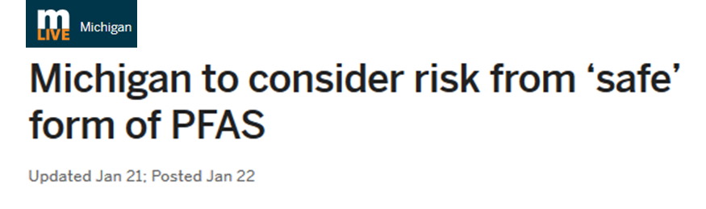
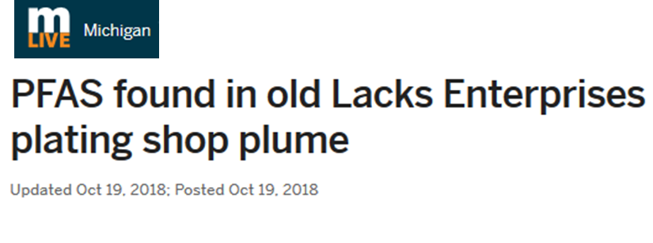
Increasing Scrutiny on ALL PFAS and Metal Plating
Legacy Uses, Environmental Liability
Replacements, Product Stewardship, Best Practices
Bipartisan Bill Introduced (March ‘19)
“PFAS Detection Act of 2019”

Slide 16
Transition to Short Fluorotelomers
Improves Risk Profile
Non-PFAS formulations aren’t effective hexavalent chromium mist suppressants
Generally accepted that fluorotelomers are:
  Less persistent
  Less bioaccumulative
  Less toxic
Data gaps remain
PFOS
6:2 FTS
Notes:
Discuss 6:2FTS performance compared to PFOS

Slide 17

Available Data to Support the Transition to 6:2 FTS –
Data gaps Remain
Supporting Data
Data Gaps
Lower human exposure to 6:2 FTS compared to PFOS
PFOS is persistent; 6:2 FTS can biodegrade
6:2 FTS is not considered bioaccumulative
6:2 FTS is less toxic than PFOS to some organisms
Few studies have monitored human exposure to 6:2 FTS
Degradation products not fully characterized
Bioaccumulation of 6:2 FTS in humans is not characterized
No long term studies and toxicity of 6:2 FTS to humans is unknown

Slide 18
What is NASF/Policy Group Doing?
PFOS
6:2 FTS
NASF PFAS Technical Working Group
Identifying and securing experts and resources
Meeting with stakeholders to understand landscape
Helping to prioritize actions

Slide 19
NASF Identified 4 Priority Issues
Why is there still residual PFOS in chrome plating shop effluent today?
What is in current PFAS formulations and what data supports its continued use?
What contribution do plating shops have to the overall load of PFAS into POTWs/WWTPs?
How to best engage and educate key stakeholders?

Slide 20
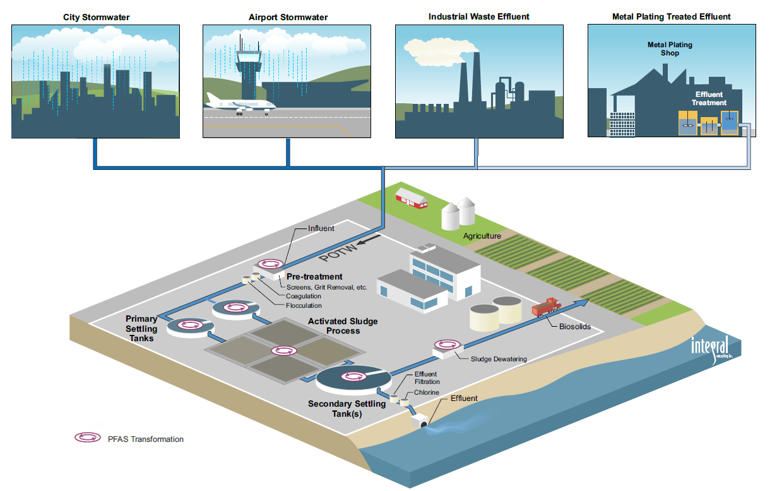
Metal Plating Shop Effluent is Only One Contributor of PFAS to POTWs

Slide 21
Key Take Home Messages
Intense state and community focus on PFAS
  Disparate regulatory actions, public mistrust, and increasing litigation
Increasing scrutiny on metal plating industry as an environmental source
NASF/Policy Group has been, and will continue to be, engaged and actively promoting
  sound science-based regulations, and
  best industry practices

Slide 22



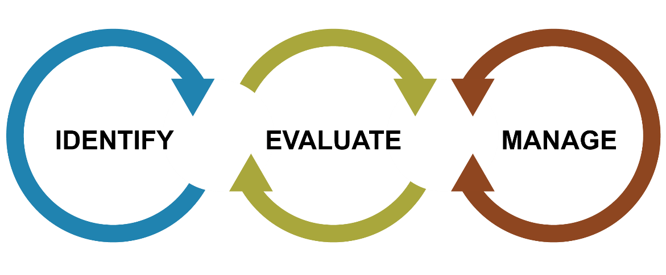
Questions?
Janet Anderson, Ph.D., DABT
Toxicologist | Senior Consultant
janderson@integral-corp.com
513.226.6528

Slide 23
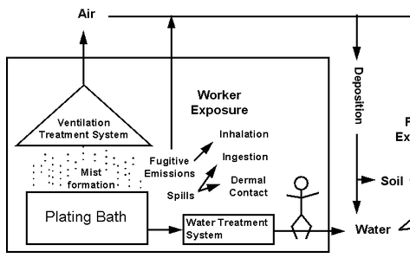
Understand Detections of PFOS in Facility Effluent
EPA Region 5 (Michigan)
Ensure sound science and logic drive sampling program and data interpretation
Collaborate with regulators & other stakeholders
Source: EPA 1998. Characterizing Risk at Metal Finishing Facilities

Slide 24
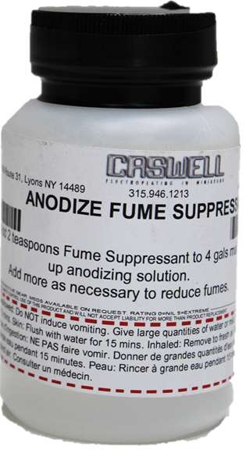
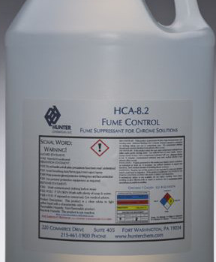
Mist Suppressant Formulations Still Contain PFAS, but Exact Formulations are Confidential
Collaborate with industry suppliers and regulators
Ensure a data-driven analytical plan that protects CBI and helps resolve questions
  Active ingredients
  Impurities
Notes:
Image of mist suppressant bottle/drum

Slide 25
Back-up Slides

Slide 26
PFOA/PFOS
Human Data Challenging to Interpret
Overall weight of evidence has NOT identified a strong association between exposure to a specific PFAS and any adverse health outcome
EPA and ATSDR: Most consistent evidence generally exists for associations with:
AUS DOH: Limited or no evidence for any causal link and any human disease
↑ Cholesterol, liver enzymes
↓ Antibody response to vaccine
Pregnancy-induced hypertension/pre-eclampsia
Risk of thyroid disease
↓ Fertility
↓ Birth weight
Associations with some health outcomes but
Limited or no evidence of human disease
Lack of clinical significance
May be explained by reverse causation or confounding factors
Notes:
animation

Slide 27


Regulatory Numbers Based on Animal Data:
Many Issues and Uncertainties…
Developmental
Immune
Liver
Thyroid
Liver
Cholesterol
  (not persistent)
Policy and precautionary principal
?
Notes:
USEPA chose developmental endpoints from rodents – bone ossification, changes in puberty markers (PFOA), and decreased neonatal body weight (PFOS)

Slide 28

States – Leading the Charge, Not Just for Drinking Water Standards and Exposure
Increasing list of analytes
Increasingly divergent priorities
Increased attention to non-AFFF sources
  Landfills
  POTWs
Additional exposure routes
  Surface water
  Effluent
  Soil
  Food
Increasing use of state legislature
  >80 Legislative bills related to PFAS issued in FY18

Slide 29
USEPA 2019 - PFAS Action Plan
Regulation (PFOA, PFOS)
CERCLA - hazardous substance listing
Toxicology
Collaboration w/industry, academia
Monitoring and Remediation
Public water supplies - expand monitoring via UCMR4
Risk Communication
Risk communication toolbox
SDWA - MCLs proposed in 2019
Interim cleanup levels
Continue research on additional PFAS
Consistency messaging across agencies
Develop new treatment technologies
TSCA - additional SNURs
Air emissions - reporting via Toxic Release Inventory
Explore AWQCs and Effluent limits

Slide 30
What Is Your PFAS Analyte List?
USEPA Method 537.1
  12 PFAAs
  2 precursors
  4 new – (GenX, ADONA, F-53B)
  18 total
Commercial labs
  ~30-44 analytes
Academia
  ~400 analytes

Slide 31
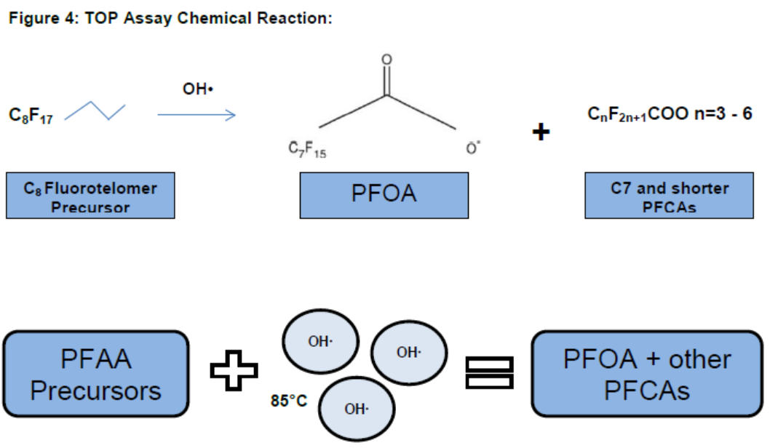
Total Oxidizable Precursor Assay
Is NOT a predictor of abiotic and biotic breakdown in environment
Useful for remedial design to account for loading, etc.
Not useful for risk assessment.
Source: TestAmerica: Closing the PFAS Mass Balance
White Paper No. CA-T-W-006, rev 1 - July, 2017

