Slide 1
NASF Washington Forum
Europe, The U.S., and California: Nickel Regulatory Trends and Update
Mike Taylor, Ph.D., DABT
Washington, D.C., April 16, 2019

Slide 2

Outline
Brief Introduction to Nickel Institute/NiPERA
Europe: Nickel Occupational Exposure Limit (OEL), Cobalt Classification and Implications for Nickel Industry
U.S. Federal: TSCA Prioritization, Risk Evaluation, and Risk Management
U.S. State: California Prop 65 and State Air Initiatives

Slide 3
Nickel Instute: What We Do
MISSION: Promote and support the safe use of nickel in appropriate applications
MARKET DEVELOPMENT
Grow and defend markets for new and existing nickel applications
SCIENCE
Undertake science relevant to human health and environment and perform risk assessments for regulatory purposes
HEALTH & ENVIRONMENT
PUBLIC POLICY
Promote sound science, risk management, and socio-economic benefit as the basis for public policy and regulation
COMMUNICATIONS
Build the nickel brand and inform
the regulatory and social debate on nickel-related issues
GOVERNANCE AND SHARED SERVICES
NI supports its Members’ licence to operate and market access
3

Slide 4















Nickel Institute Member Companies
AngloAmerican Marketing Ltd
AngloAmerican Platinum
Vale Canada Limited
PT Vale Indonesia Tbk
Vale Japan Limited
Global leaders in nickel production

Slide 5
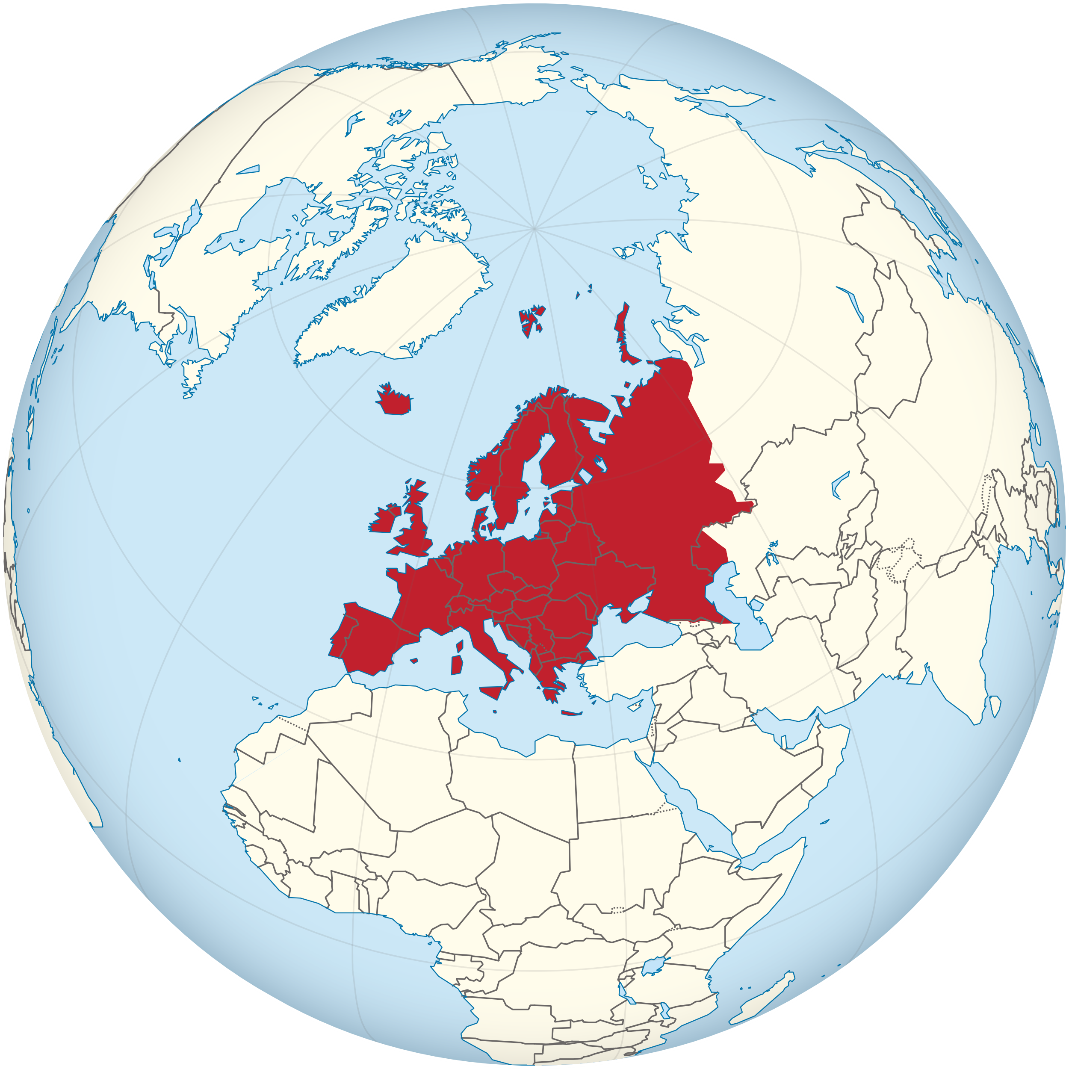
European Developments

Slide 6


EU: Challenges and Opportunities
Overly ambitious, unrealistic targets
  Toxic free environment
  Circular economy
  Zero emissions
  Carbon free economy
Underlying principles of EU legislation
Science & risk based legislation
Precaution only when no sufficient evidence
Full life cycle thinking, impact assessment
But: the reality looks often different
Hazard classifications as basis for decisions
Precautionary principle used even if scientific evidence exists
Only parts of life cycle / value chain are assessed, impacts are ignored
Target conflicts between EU institutions
Ban hazardous substances vs. green mobility
Emission trading vs. low carbon economy
Occupational health vs. jobs and growth

Slide 7
Occupational Exposure Limits (OELs) in Europe:
Background and NI Perspective
Mar. 2018: ECHA RAC adopted scientific Opinion:
  Inhalable OELV 0.03 mg Ni/m³ for Ni compounds
  Respirable OELV 0.005 mg Ni/m³ for Ni metal and Ni compounds
  SEN notation
RAC Respirable OELV should be carefully considered as it raises significant challenges (feasibility, measurability, compliance)
 | SCOEL (2011) | ECHA RAC (2018) | NiPERA
Inhalable Fraction | 0.01 mg Ni/m³ | 0.03 mg Ni/m³ | 0.05 mg Ni/m³
Respirable Fraction | 0.005 mg Ni/m³ | 0.005 mg Ni/m³ | 0.01 mg Ni/m³
RAC values within 2 fold of NiPERA values
NiPERA OELVs are fully protective while being more implementable

Slide 8
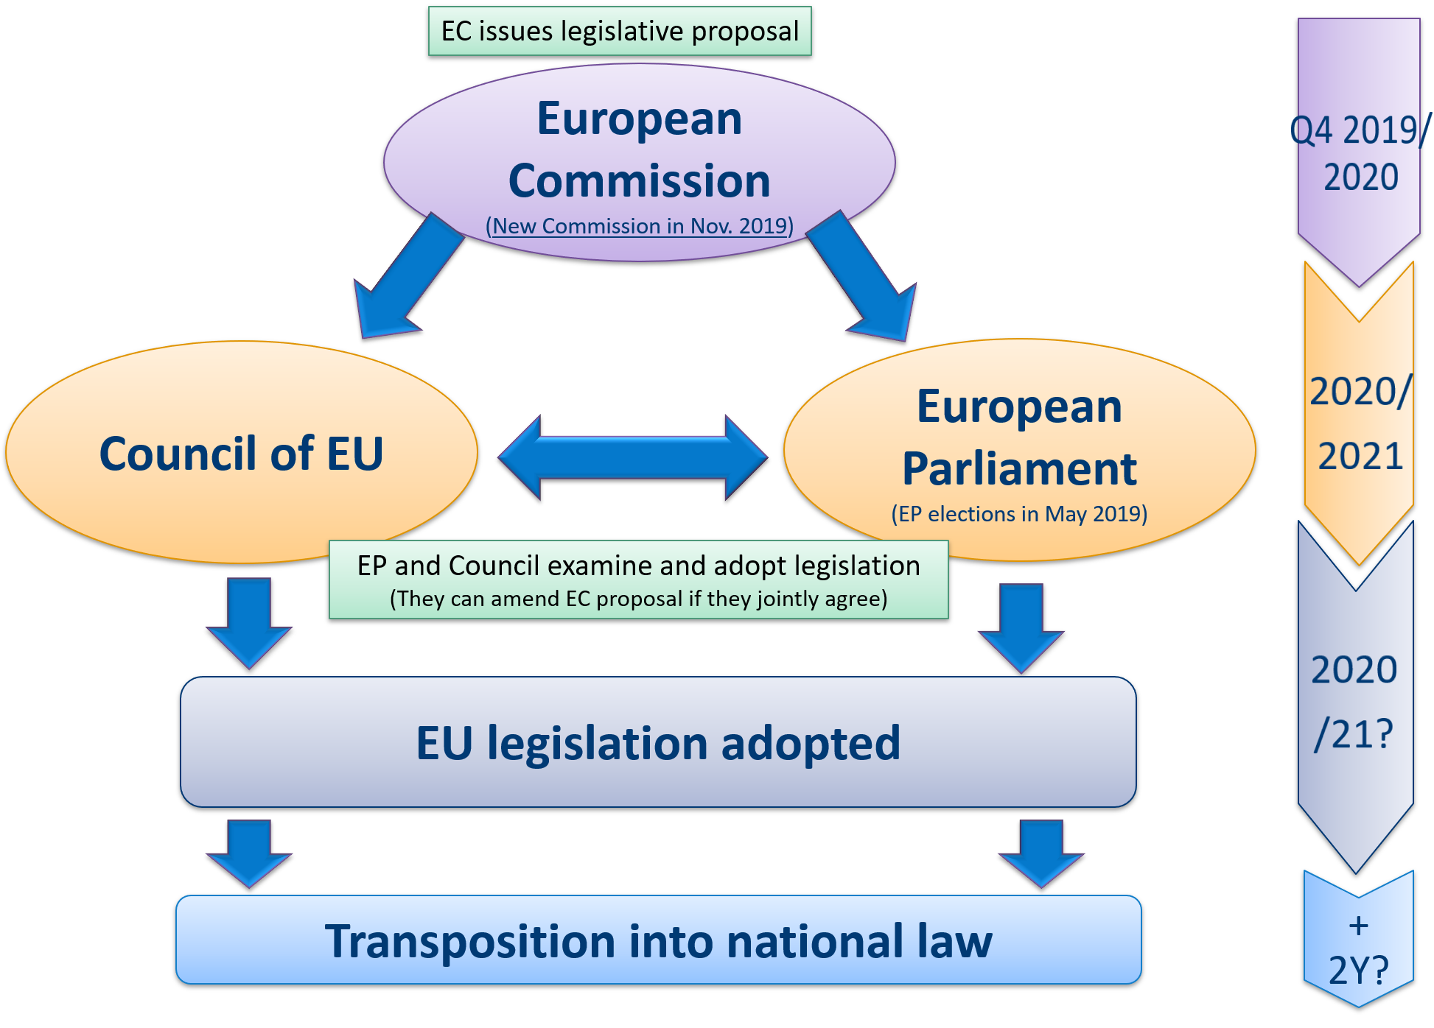
Occupational Exposure Limits (OELs) in Europe:
Status and Next Steps
EC to consult “social partners and governments”
Socioeconomic analysis to understand the balance between compliance costs and health benefits
Tripartite Advisory Committee on Health and Safety Opinion
EC Impact Assessment Report
EU legislative proposal to set OELV for nickel compounds expected in 2019/20 Revision of Carcinogens and Mutagens Directive
NI to continue to follow process and engage with stakeholders
Aim: OELVs that are fully protective while being more implementable
Notes:
Will not go through this slide in much detail – just point out there are steps happening this year leading up to the legislative proposal, and then once that’s done, it’s a complicated and lengthy process to make it to the final law. NI to continue to follow process, provide information, and engage with stakeholders.
Mike, just for clarification, the steps on the left are all taking place prior to the first box on the right. Could mention high NI engagement in SEA. ACSH is meeting end of April

Slide 9


EU Cobalt Metal Classification Proposal:
Impact
EU Proposal to classify Cobalt metal as:
Carcinogen Category 1B for all routes of exposure (0.01%)
Reprotox Category 1B
Mutagen Category 2
    Nickel and nickel-containing stainless steel at risk of being classified as carcinogen by inhalation, ingestion and dermal contact
    This puts at risks important and critical applications such as:
Medical devices such as surgical instruments
Every day household products: pots, pans, cutlery, …
Industrial applications e.g. food processing
Applications in public places: handrails, kitchens, …
Critical infrastructure such as water pipelines
Impacts on US industrial value chains
  Stigmatization of US consumer goods containing cobalt
  Market access endangered for certain markets
  Legal implications

Slide 10
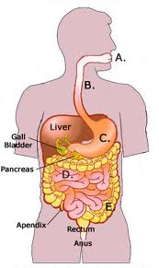
EU Cobalt Metal Classification Proposal:
Strategy
Address potency
  Flawed methods contributed to initial cut-off value of 0.01%
  Expert Group to be set up to assess the methodology to derive the potency
Promote “bioaccessibility” concept for alloys containing Co
  Measures metal release in physiological fluids
  Provides realistic estimate of bioavailable dose from Co in alloy
Socioeconomic dimensions
  Alert member states and WTO countries on impacts from classification proposal
    US WTO Delegation submitted written statement on 14th ATP
A
B
Systemic absorption
Source
Co compound
Bioavailable Co²⁺
Acute oral toxicity
Reproductive toxicity
Gastric fluid
Systemic effects
Bioaccessible Co²⁺
Intestinal fluid
Technical discussions with European Commission and ECHA to keep impact as limited as possible & to protect major end use markets
Notes:
So what can we do?
On the technical side, we are pointing out some of the flaws in the methodology. One of these deals with the decisions around the cancer potency of Co. We disagree with the basis argued by the NL on the grounds that it uses faulty read across. Mike is not faulty read across. Is faulty method based on a database with mostly organic substances and mostly oral carco studies that can not be extrapolated to inhalation or metals
This alone won’t do it, so, we also want to promote the use of “bioaccessibility”
Bioaccessibility is based on the observation that the actual fraction of ingested or inhaled metal is a small proportion of total metal. Usually it is lower than 20%. No Mike: based on the fact that toxicity of metals is due to metal ion; that alloys have matrix effects that modify metal release compared to pure metals and therefore a classification comparing bulk concentrations to cutoff values could over or underestimate toxicity
Using this approach, a bioaccessible concentration of Co from an alloy or Ni can be measured, and compared with the SCL. If it’s lower, then no classification.

Slide 11

EU Cobalt Metal Classification Proposal:
Developments
April 11-12, 2019: Discussion on 14th ATP comprised a wide range of substances
  TiO₂ is discussed jointly with Cobalt metal
    Significant imports, wide range of end uses
No vote on ATP - Commission took the ATP item off the agenda
    Postpones the possible entry into force of the cobalt classification
    Could be brought back up in June 2019 meeting
    Could be in new process called Delegated Acts Procedure
      legally binding acts that enable the Commission to supplement or amend non essential parts of EU legislative acts, for example, in order to define details
Recent developments led to further delays in decision process – unclear path for forthcoming decision-making

Slide 12
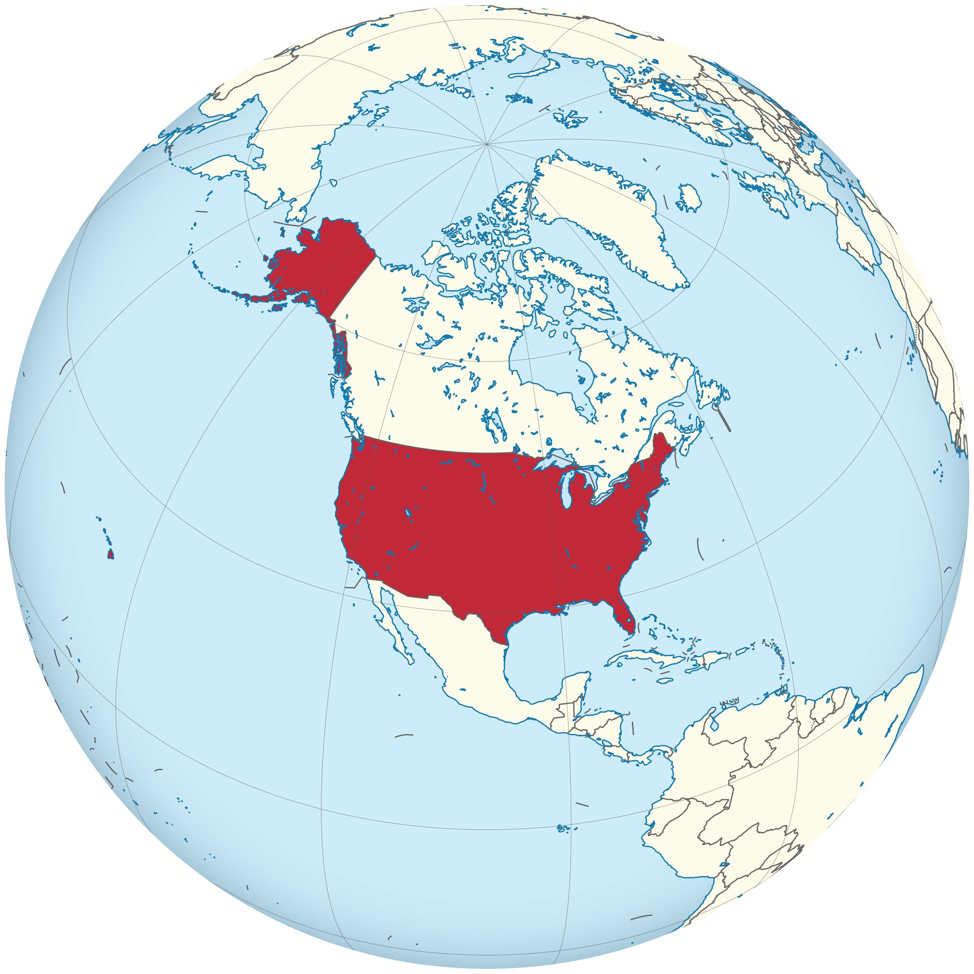
U.S. Federal Developments

Slide 13
TSCA Framework for Existing Chemicals: Prioritization, Risk Evaluation, and Risk Management
The Frank Lautenberg Chemical Safety for the 21st Century Act of 2016
Identify Chemicals
Evaluate
Determine
Manage Risk
Prioritize
Active substances
High-priority chemicals
Low priority chemicals
Inactive substances
Testing and assessment
Unreasonable risk to health and environ-ment?
Restriction
Ban
Enforcable deadlines for each step
Key Stages – Prioritization, Risk Evaluation, Risk Management

Slide 14
EPA TSCA Program: Identification of Candidate Chemicals for Prioritization
Major Milestone Just Reached
EPA released 20 high and 20 low priority candidate chemicals on March 20, 2019
All 20 high priority chemicals drawn from agency’s TSCA 2014 Work Plan Chemical List (only 50% required)
    Seven chlorinated solvents
    Six phthalates
    Four flame retardants
    Formaldehyde
    A fragrance additive
    A polymer pre-curser
December 2019 deadline for next 20 risk evaluations to be underway & identification of 20 final low priorities
Nickel & Nickel Compounds on the TSCA Work Plan List
Screening Criteria for TSCA Work Plan:
Hazard
Exposure
Persistence & Bioaccumulation
Nickel & Nickel Compounds NOT Identified for TSCA Prioritization

Slide 15
TSCA Evaluation is Good for Nickel Thus Far...
But it’s very early in the new process
Key Considerations
Nickel & Nickel Compounds On TSCA Work Plan List
All TSCA Work Plan chemicals will eventually be prioritized – as either High or Low Priority
A “high priority” designation triggers a risk evaluation
  Key question: Does the chemical present an unreasonable risk to health and the environment for each condition of use?
  Stated goal: high-quality risk evaluations that rely on the best available science and the weight of the scientific evidence
  Fee amount for EPA-initiated risk evaluations = $1.35 Million from industry
Outlook
When EPA completes a risk evaluation on the current high priority list, it must replace it with another high priority chemical for risk evaluation
EPA will have at least 20 initiated risk evaluations AT ALL TIMES beginning in December 2019
Nickel & Nickel Compounds will eventually be prioritized – High or Low

Slide 16
TSCA Prioritization and Evaluation: Informing EPA Risk Assessments for Metals
Congress Mandated Use of EPA’s Framework for Metals Risk Assessment (Metals Framework) in EPA’s “identifying priorities for risk evaluation and conducting risk evaluation for metals and metal compounds” under TSCA
  Metals Framework is a science-based document that takes into consideration the unique attributes and behaviors of metals and metal compounds when assessing their human health and ecological risks

Slide 17
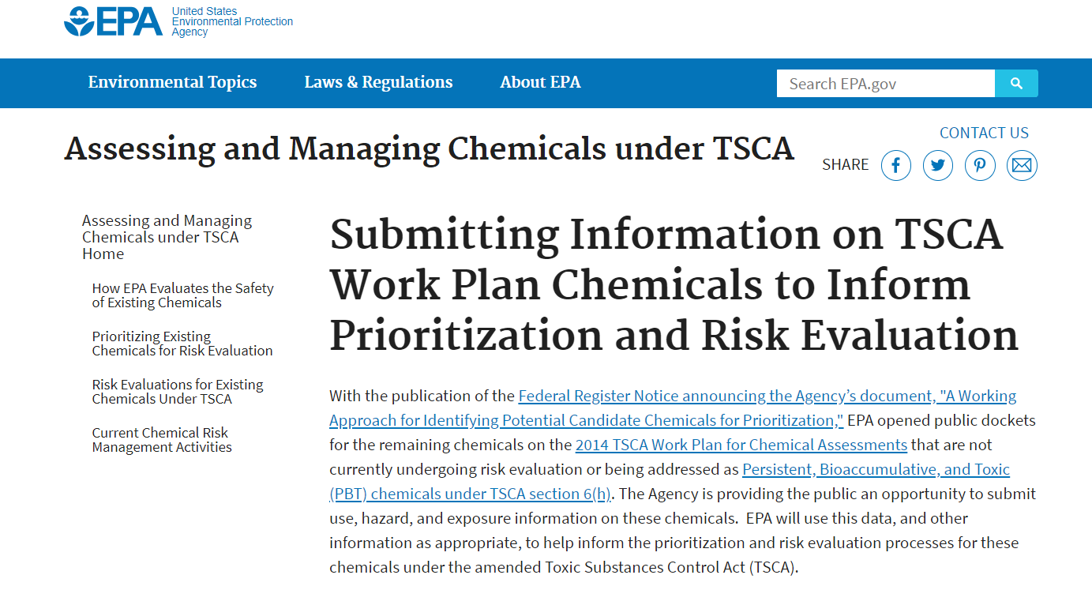
TSCA Prioritization and Evaluation: Informing EPA Risk Assessments for Metals
Each TSCA Work Plan Chemical has a separate Docket for submitting use, hazard & exposure information, conditions of use, applicable regs in place and completed partial risk evaluation
Interested Parties Can Submit Info - Docket Open Until December 2019

Slide 18

California and State Developments

Slide 19
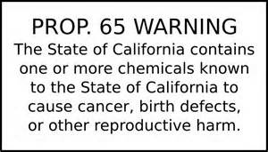
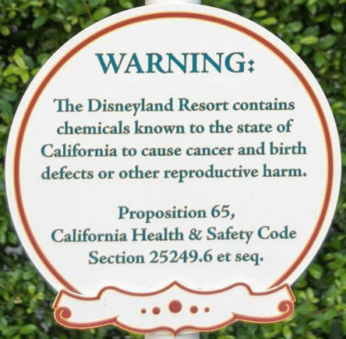
California Prop 65 Initiative for New Listing of
Nickel and Nickel Compounds
Background:
The Safe Drinking Water and Toxic Enforcement Act of 1986, better known as Proposition 65, requires the state to publish a list of chemicals known to cause cancer or birth defects or other reproductive harm
Prop 65 requires businesses to notify the public about listed chemicals in the products they purchase, in their homes or workplaces, or that are released into the environment
Nickel and Ni compounds are now listed on Prop 65 for cancer by inhalation (alloys containing Ni are exempt)
Recent Actions – 2015 – 2019:
In 2015, California launched formal proposal to list Nickel and Ni compounds for developmental and reproductive toxicity via a multi-stage review process
Repro listing proposed would require labeling on products
that contain nickel which may be ingested
19

Slide 20
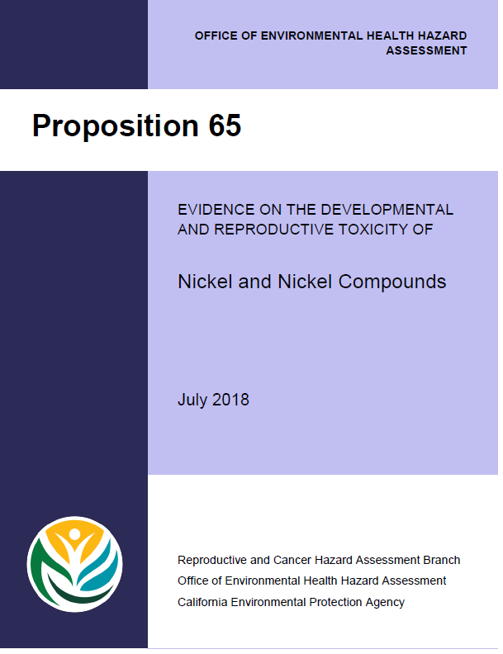



Recent Steps – Nickel and Nickel Compounds as Developmental and Reproductive Toxicants
Actions:
In July 2018, CAL EPA (OEHHA) released a 347 pg “Hazard Identification Document” on the developmental and reproductive toxicity effects of Nickel and Ni compounds
NiPERA organized and submitted substantial written comments using internal and external experts in Sept 2019 for review by the Developmental and Reproductive Toxicant Identification Committee (DARTIC)
Written comments reviewed all of the reproductive and developmental toxicity data in animals and humans and concluded that only the listing of soluble nickel compounds for developmental toxicity in animal studies was warranted by the data
SKS Consulting
Substantial comment package submitted to DARTIC and
comments from the North American Nickel Stakeholders Group
20

Slide 21
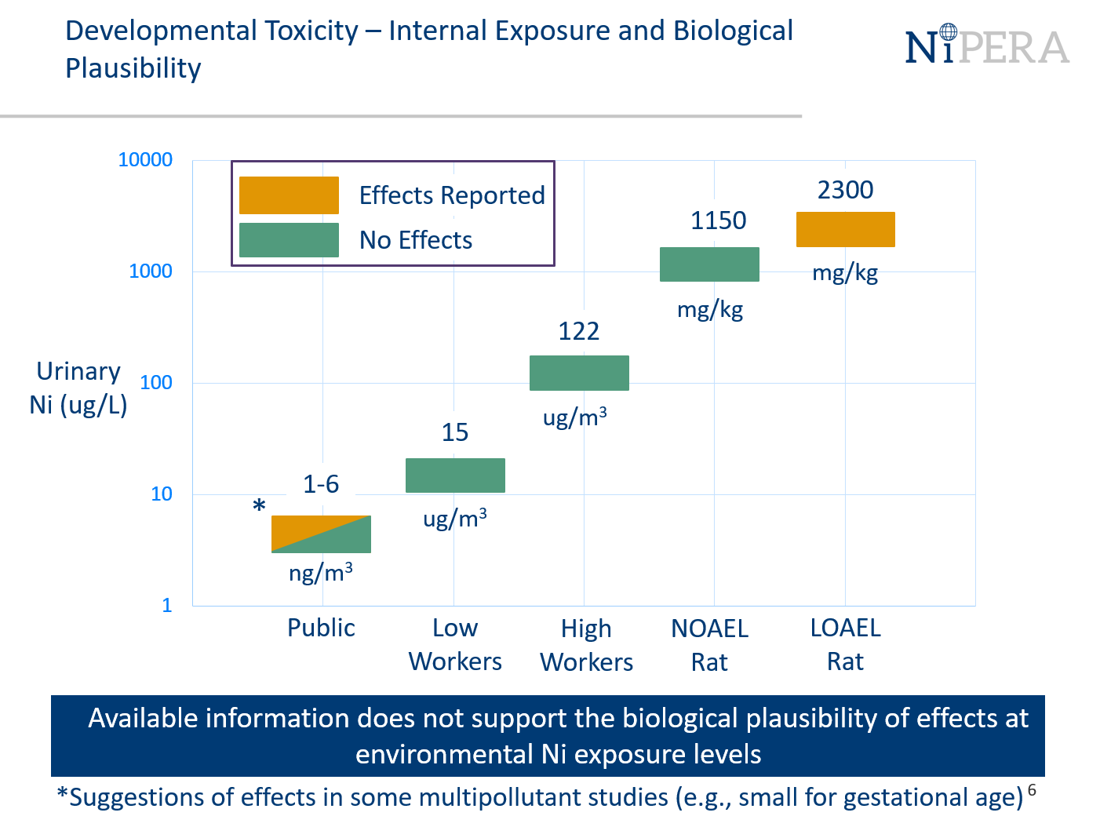
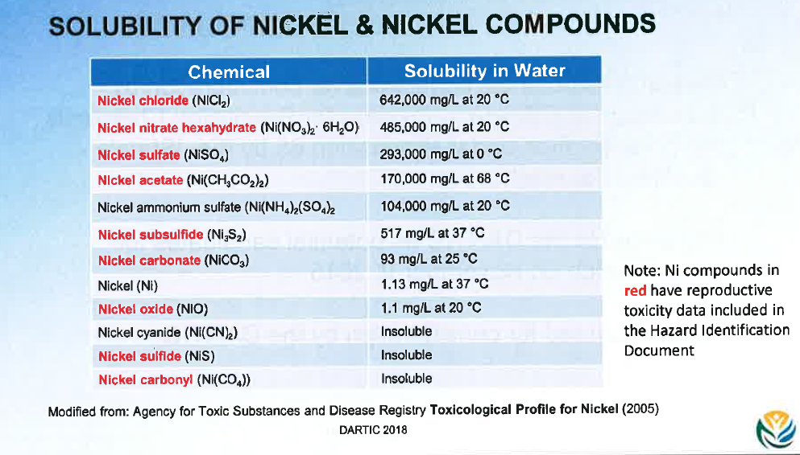
October Hearing – California Prop 65 Listing for Nickel and Nickel Compounds
DARTIC hearing held on Oct 11, 2018
NiPERA urged DARTIC to consider soluble Ni compounds, insoluble Ni compounds, and Ni metal separately
NiPERA concluded the only effects that warranted listing are the developmental toxicity effects seen in animal studies with soluble Ni compounds
Outcome:
After wide-ranging deliberation and an additional intervention from NiPERA, DARTIC voted to list only “soluble Ni compounds” for developmental and male reproductive toxicity
Lingering question: “what is a soluble compound?”
Key discussions post-hearing with senior officials to set up subsequent face to face meeting
Avoided Ni metal and insoluble Ni compounds being inappropriately
labeled as a reproductive/developmental toxicant
21

Slide 22
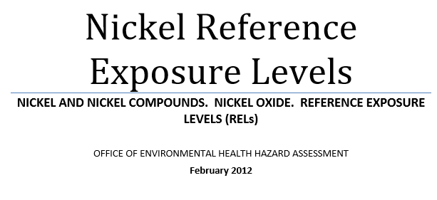
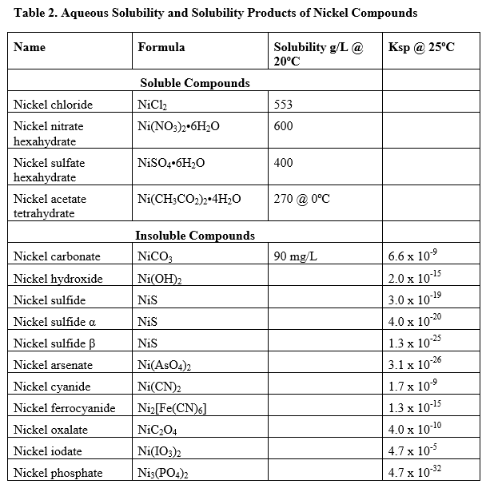
Successful Outcome and Follow Up – Prop 65 Listing for Nickel and Nickel Compounds
Meeting in Dec 2018 with California officials to:
Define “soluble Ni compounds”
Recommend appropriate starting point for setting a Maximum Allowable Dose Level (MADL) for soluble Ni
Reminded them they (OEHHA) has previously defined soluble nickel compounds in 2012 Nickel REL derivation
Solubility threshold considered >0.1 mol/L:
“Insoluble compounds have solubility <0.01 mol/L, soluble compounds have solubility >0.1 mol/L and slightly soluble compounds range between 0.01 and 0.1 mol/L. Insoluble nickel compounds have solubility products that range from about 1 x 10⁻⁹ to 1 x 10⁻³¹ (Table 2).” (emphasis added)
Reinforced this definition and approach in meeting
22

Slide 23
European Union Water Solubility Grouping
OEHHA’s previously defined soluble nickel definition fits with the EU’s solubility definition used to establish reprotoxicity classification
European Commission determined in 2008 that soluble Ni compounds met the hazard classification criteria for developmental toxicity (animal evidence)
Insoluble Ni compounds and metallic Ni did not based on lack of bioavailability
Solubility threshold >0.1 mol/L
Category | Water Solubility (mol/L)
Insoluble | <10⁻⁴
Slightly soluble | 10⁻⁴ – 10⁻²
Soluble | 10⁻² – 5∙10⁻¹
Very Soluble | >5∙10⁻¹
No Repro
Classification
Repro
Classification
OEHHA using the same definition as the EU would provide global consistency

Slide 24
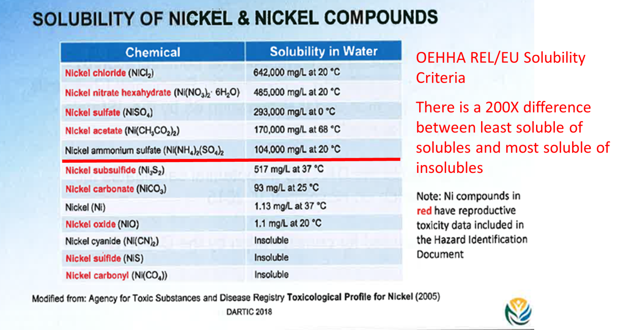
Follow Up and Next Steps – Prop 65 Listing for Nickel and Nickel Compounds
Next Steps:
Continued engagement with California officials to:
Achieve appropriate definition of “soluble Ni compounds” under Prop 65
Guide state decision making for setting Maximum Allowable Dose Levels (MADLs) for soluble Ni
Clarify with regulators and downstream user community when labeling is and is not required
Continued engagement to achieve appropriate outcome
24

Slide 25
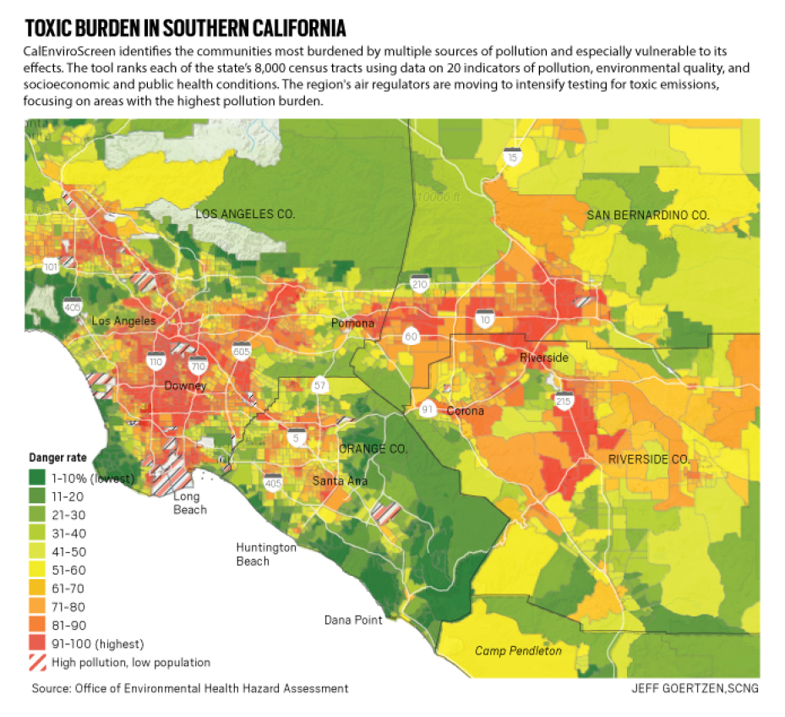
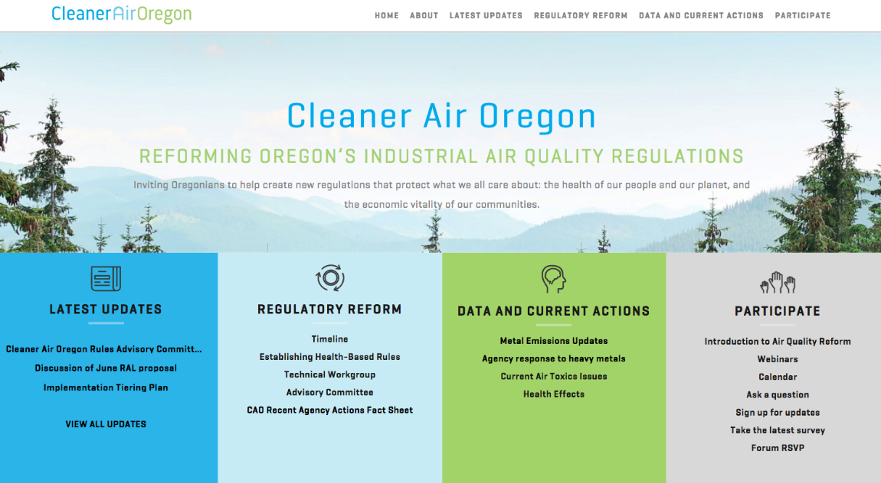
Nickel Air Regulation in the States:
California and Oregon Proposals Continue to Advance
California:
Los Angeles and state officials focusing on metals emissions from manufacturing operations
Proposed rule for nickel, zinc, cadmium and lead in January 2019 for Los Angeles region
Outlook: Ongoing discussions with senior officials
Oregon:
Engagement on science and economic feasibility
Nickel regulatory thresholds are flawed
Met with chief of state’s environmental agency
  Did not rely on “authoritative bodies”
  Did not consider the most recent science
Outlook: Final air requirements pending
Engagement on science and socioeconomic impacts
to prevent precedent-setting standards for nickel
25

Slide 26


Conclusions
Global direct or indirect regulatory activities involving nickel is high and dynamic
NiPERA continues to address regulatory activities by
  Ensuring that the most up to date scientific information is recognized and appropriately interpreted
  Working with our colleagues in the Nickel Institute to access relevant technical audiences

Slide 27
Thank you!
Questions?
mtaylor@nipera.org

